Slide 1
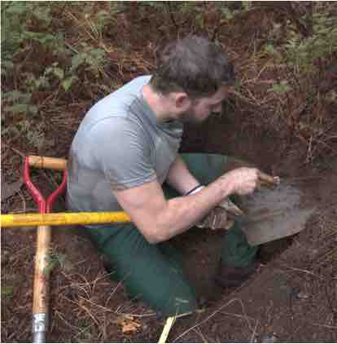
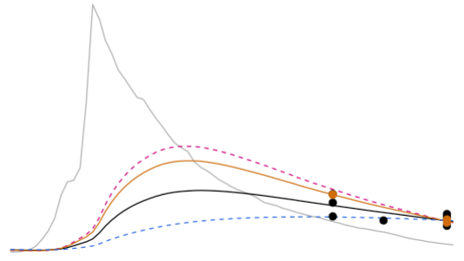
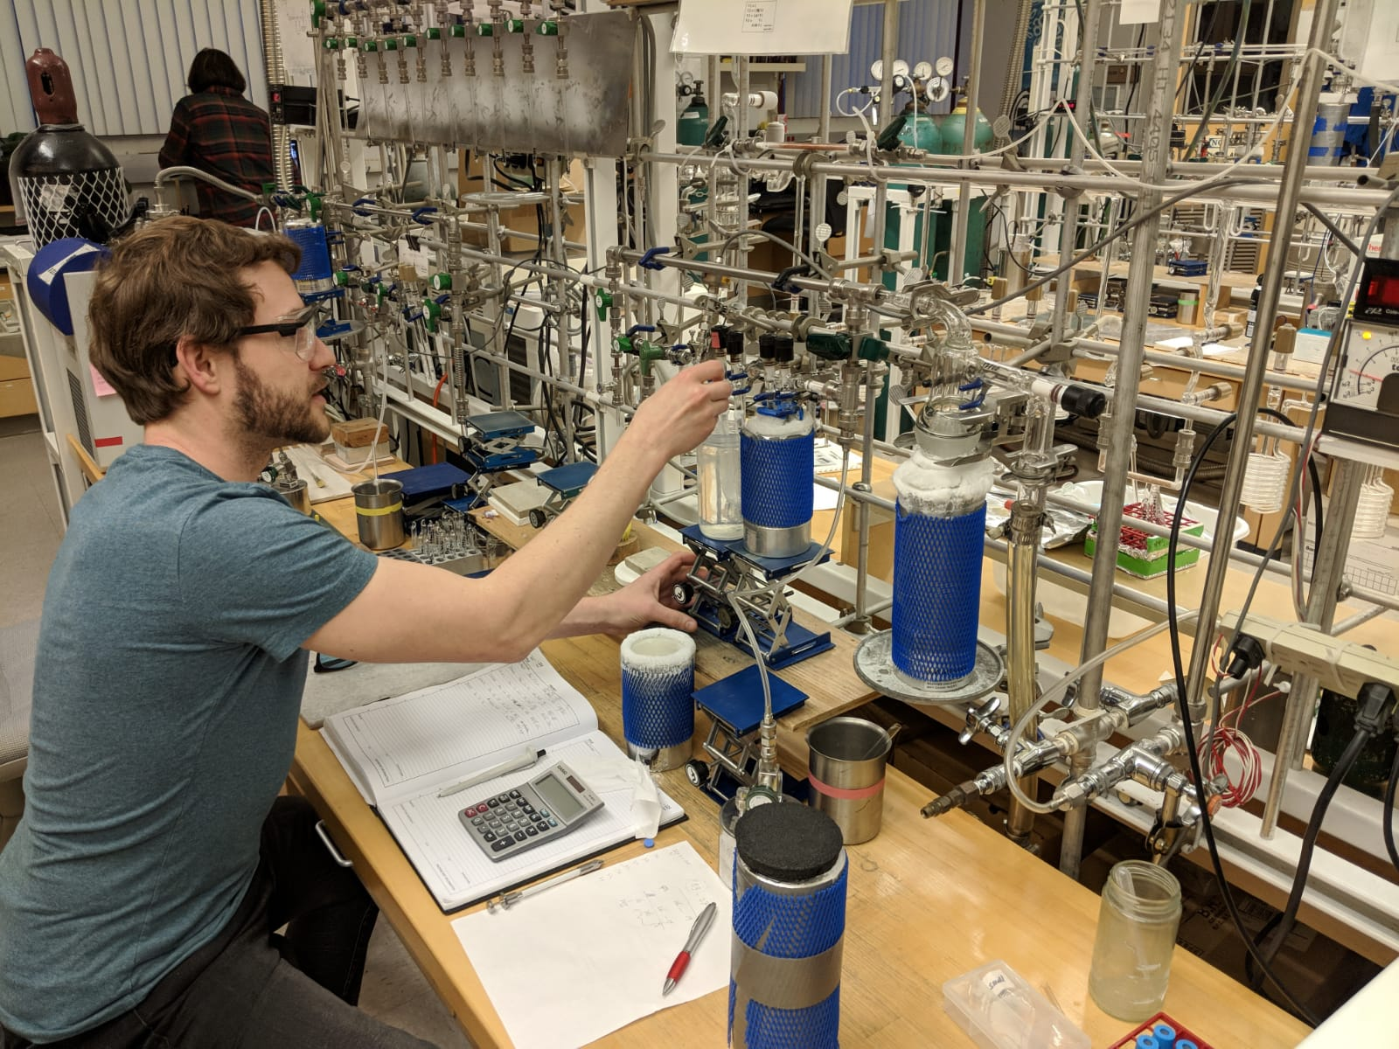



Radiocarbon constraints reveal time scales of soil carbon persistence
Jeff Beem-Miller, PhD
University of Michigan and Lawrence Berkeley National Laboratory
Forum Biogeochemistry and Landscape Dynamics 23 Oct., 2024
Beem-Miller FoBL Seminar
23 October 2024

Slide 2
CLIMATE CHANGE AND SOIL C
What drives soil C stock changes?

Slide 3
CLIMATE CHANGE AND SOIL C
inputs
+
What drives soil C stock changes?
+ decomposition
Notes:
two competing pathways
1) more storage of atmospheric CO2 in soils
2) soil carbon losses, exacerbating warming
Green = increased C inputs
enhanced primary production via warming and CO2 fertilization
Red = increased decomposition rates due to warmer temperatures

Slide 4
CLIMATE CHANGE AND SOIL C
inputs
+
500
250
Change in soil C stocks by 2100
(Pg C)
0
-250
-500
+ decomposition
Ensemble of global soil C models
Model mean
Multi-model mean
± sd
(figure adapted from Todd-Brown et al., 2018)
Notes:
net change is positive [Multi-model mean: 88 ±153 Pg C]
takeaway: global soil carbon models do not agree
all models predict substantial increases in inputs
by a relative factor of 1.4
However, there less agreement with regards to the increased decomposition pathway
[NB: high emissions scenario relative concentration pathway of 8.5]

Slide 5
CLIMATE CHANGE AND SOIL C
inputs
+
500
250
Change in soil C stocks by 2100
(Pg C)
0
-250
-500
+ decomposition
Ensemble of global soil C models
Model mean after adjusting temperature sensitivity (Q10)
Multi-model mean
± sd
(figure adapted from Todd-Brown et al., 2018)
Notes:
Improved decomposition by rescaling Q10 w/ empirical data from soil warming experiments
after rescaling, multi-model mean declines [to 19 Pg C from 88 Pg C; similar sd]
overall picture is still one of confusion---the model estimates are all over the place
This is because temperature sensitivity of soil organic matter decomposition is not a simple Arrhenius relationship

Slide 6
SOIL C PERSISTENCE
What controls soil C persistence?
Notes:
Let’s dig into decomposition…

Slide 7
SOIL C PERSISTENCE
What controls soil C persistence?
persistence: the probability that a given atom of C in the soil will remain in the soil
Notes:
i.e., opposite of decomposition

Slide 8
SOIL C PERSISTENCE
What controls soil C persistence?
Temperature
Notes:
higher temperatures = faster decomposition = lower persistence

Slide 9
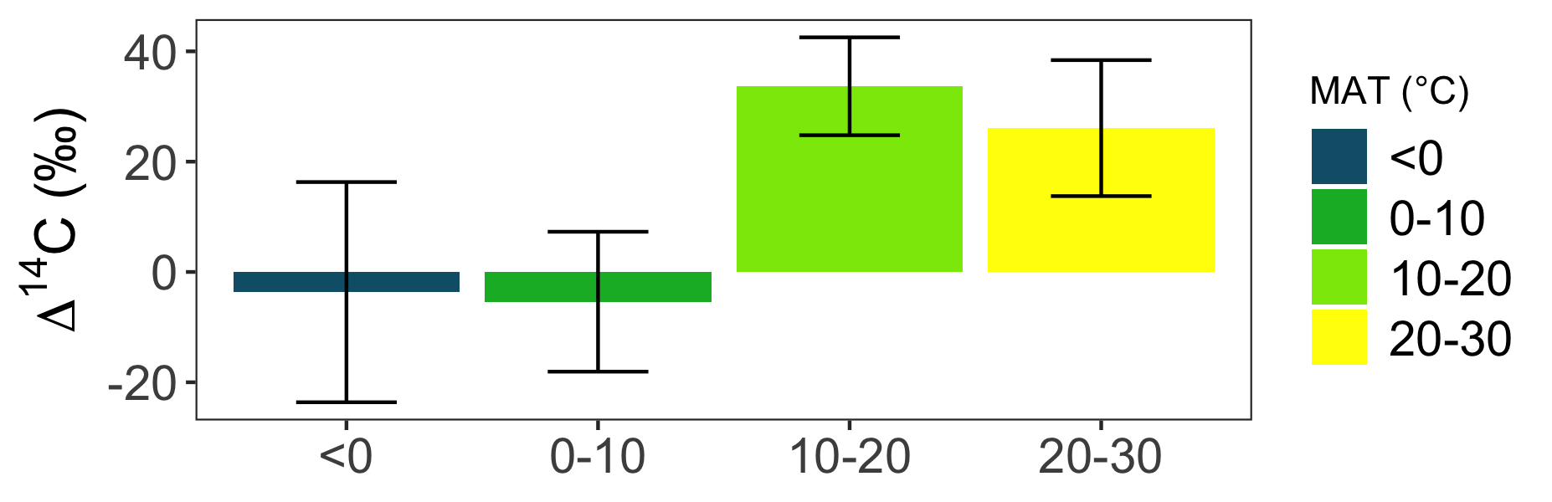
SOIL C PERSISTENCE
What controls soil C persistence?
Temperature
a)
MAT (°C)
Global distribution of ∆¹⁴C in soil (<0.3 m)
MAT = mean annual temperature
(Data from ISRaD) assemblage
Notes:
Clear patterns in bulk soil radiocarbon values by MAT
∆14C cold < ∆14C warm
high variability, i.e., temperature is not the only factor
plots in file “israd_dynaminx.R”

Slide 10
SOIL C PERSISTENCE
What controls soil C persistence?
Temperature
Soil minerals
a)
MAT (°C)
Global distribution of ∆¹⁴C in soil (<0.3 m)
MAT = mean annual temperature
(Data from ISRaD) assemblage
Notes:
Why minerals?
1) energy
2) physical isolation
highly reactive minerals key, i.e., high surface area and charge

Slide 11
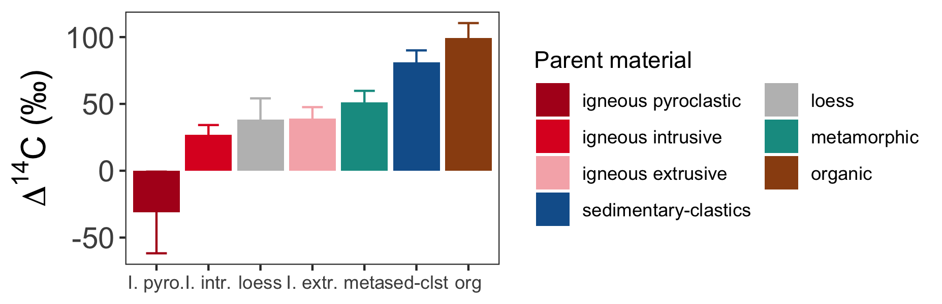
SOIL C PERSISTENCE
What controls soil C persistence?
Temperature
Soil minerals
a)
MAT (°C)
b)
Parent material
Global distribution of ∆¹⁴C in soil (<0.3 m)
MAT = mean annual temperature
(Data from ISRaD) assemblage
Notes:
parent material a useful proxy for reactive mineral content at global scale

Slide 12
RESEARCH QUESTIONS
Do soil mineral assemblages affect temperature sensitivity of soil carbon persistence?

Slide 13
RESEARCH QUESTIONS
Do soil mineral assemblages affect temperature sensitivity of soil carbon persistence?
On which time scales are soil mineral assemblages relevant for predicting soil carbon persistence?
Notes:
Do minerals only matter for slowly cycling soil C?
OR, are they relevant for soil C cycling on annual to decadal time scales?

Slide 14
RESEARCH QUESTIONS
Do soil mineral assemblages affect temperature sensitivity of soil carbon persistence?
On which time scales are soil mineral assemblages relevant for predicting soil carbon persistence?
Can we improve predictions soil carbon stock changes in response to rising temperatures by incorporating information about soil mineral assemblages?

Slide 15
METHODS

Slide 16
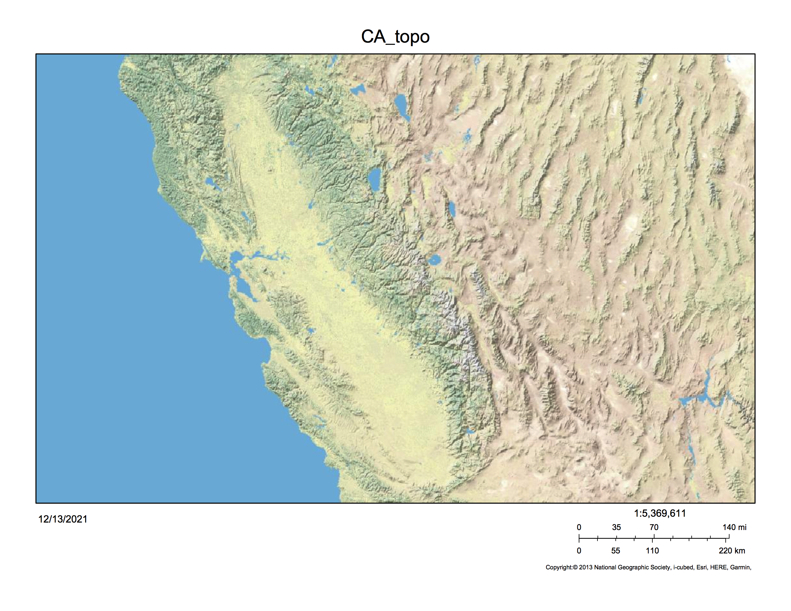
STUDY SITES
San Francisco
100 km
Sierra Nevada Mtns, California, USA
cf. Rasmussen 2004; Rasmussen et al., 2006; 2007; 2008; 2010; 2018
Notes:
Sites established by my colleague Craig Rasmussen

Slide 17
STUDY SITES
100 km
Notes:
North to south parent material gradient, temperature gradient with elevation
Archived soils available from previous work by Craig Rasmussen and colleagues
timeseries key for 14C constraint

Slide 18
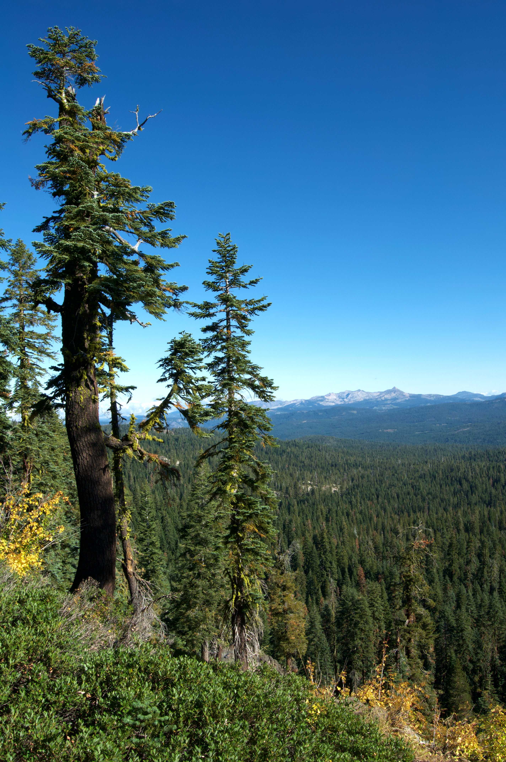
STUDY SITES
100 km
Mixed conifer biome
Notes:
consistent vegetation (California mixed conifer)
[albeit slight differences in litter chemistry, cf. Rasmussen et al., 2006]

Slide 19
STUDY SITES
Basalt
Andesite
Granite
100 km
Notes:
Soil mineral assemblages change with parent material, but temperature too
Mineral assemblages thoroughly characterized w/ previous work

Slide 20
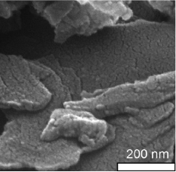
STUDY SITES
pyrophyllite
Basalt
1:1 phyllosilicates, 2:1 clays & SRO
Andesite
Granite
100 km
Images from Mikutta et al., 2007
Notes:
Basalt:
warm sites: kaolinite 1:1
[picture shows pyrophyllite, which has similarly neutral siloxane surfaces]
cool & cold: interlayered 2:1 clays (smectite and vermiculite)
some SRO iron and aluminum hydroxides and oxyhydroxides

Slide 21
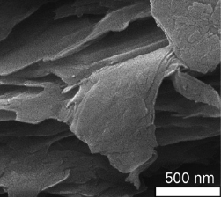
STUDY SITES
pyrophyllite
Basalt
1:1 phyllosilicates, 2:1 clays & SRO
vermiculite
Andesite
2:1 clays, SRO & allophane
Granite
100 km
Images from Mikutta et al., 2007
Notes:
Andesite:
interlayered 2:1 clays (smectite and vermiculite)
Abundant short range order iron and aluminum hydroxides and oxyhydroxides
also substantial amounts of allophane in the higher elevation sites

Slide 22
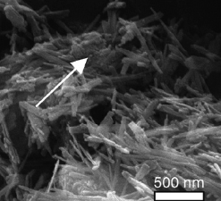
STUDY SITES
pyrophyllite
Basalt
1:1 phyllosilicates, 2:1 clays & SRO
vermiculite
Andesite
2:1 clays, SRO & allophane
Granite
1:1 phyllosilicates & crystalline Fe (oxy)hydroxides
goethite
100 km
Images from Mikutta et al., 2007
Notes:
Granite:
predominately kaolinite and some non-expanding 2:1 clays
crystalline phase iron oxides
[I am showing goethite here as an example, although the mineralogical characterization of these soils only found trace amounts of goethite]

Slide 23
STUDY SITES
Basalt
Andesite
Granite
100 km
Notes:
OK, so what do these soils look like?

Slide 24
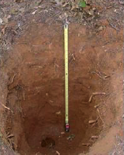
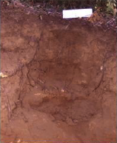
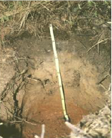
STUDY SITES
WARM
Basalt
Andesite
Granite
100 km
Notes:
highly weathered, warm climate sites

Slide 25
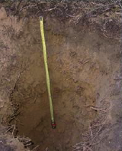
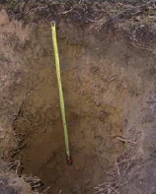
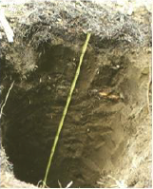
STUDY SITES
WARM
COOL
Basalt
Andesite
Granite
100 km
Notes:
moderately developed cool climate soils, rich in secondary minerals

Slide 26
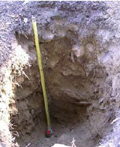
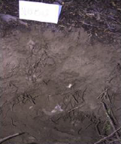
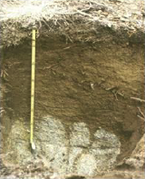
STUDY SITES
WARM
COOL
COLD
Basalt
Andesite
Granite
100 km
Notes:
young, shallow, rocky soils, rich in primary minerals

Slide 27
STUDY SITES
9 sites
Basalt
Andesite
Granite
100 km

Slide 28
STUDY SITES
9 sites
3 sampling years (2001, 2009, 2019)
Basalt
Andesite
Granite
100 km

Slide 29
STUDY SITES
9 sites
3 sampling years (2001, 2009, 2019)
3 depths (0-0.1 m, 0.1-0.2 m, 0.2-0.3 m)
Basalt
Andesite
Granite
100 km

Slide 30
STUDY SITES
9 sites
3 sampling years (2001, 2009, 2019)
3 depths (0-0.1 m, 0.1-0.2 m, 0.2-0.3 m)
Analyses:
%C and %N
density fractions (free light, occluded light, heavy)
∆¹⁴C (bulk soil, respired CO2, density fractions)
Basalt
Andesite
Granite
100 km
Notes:
density fractionation in order to quantify the mineral associated soil organic matter pool
Laboratory soil incubations key tool [next]

Slide 31
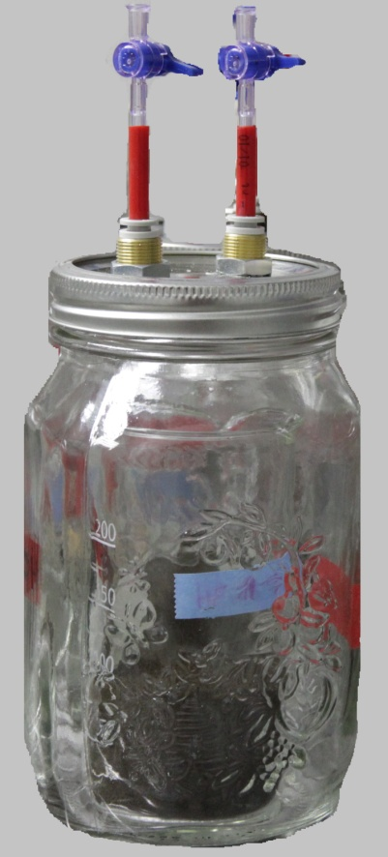
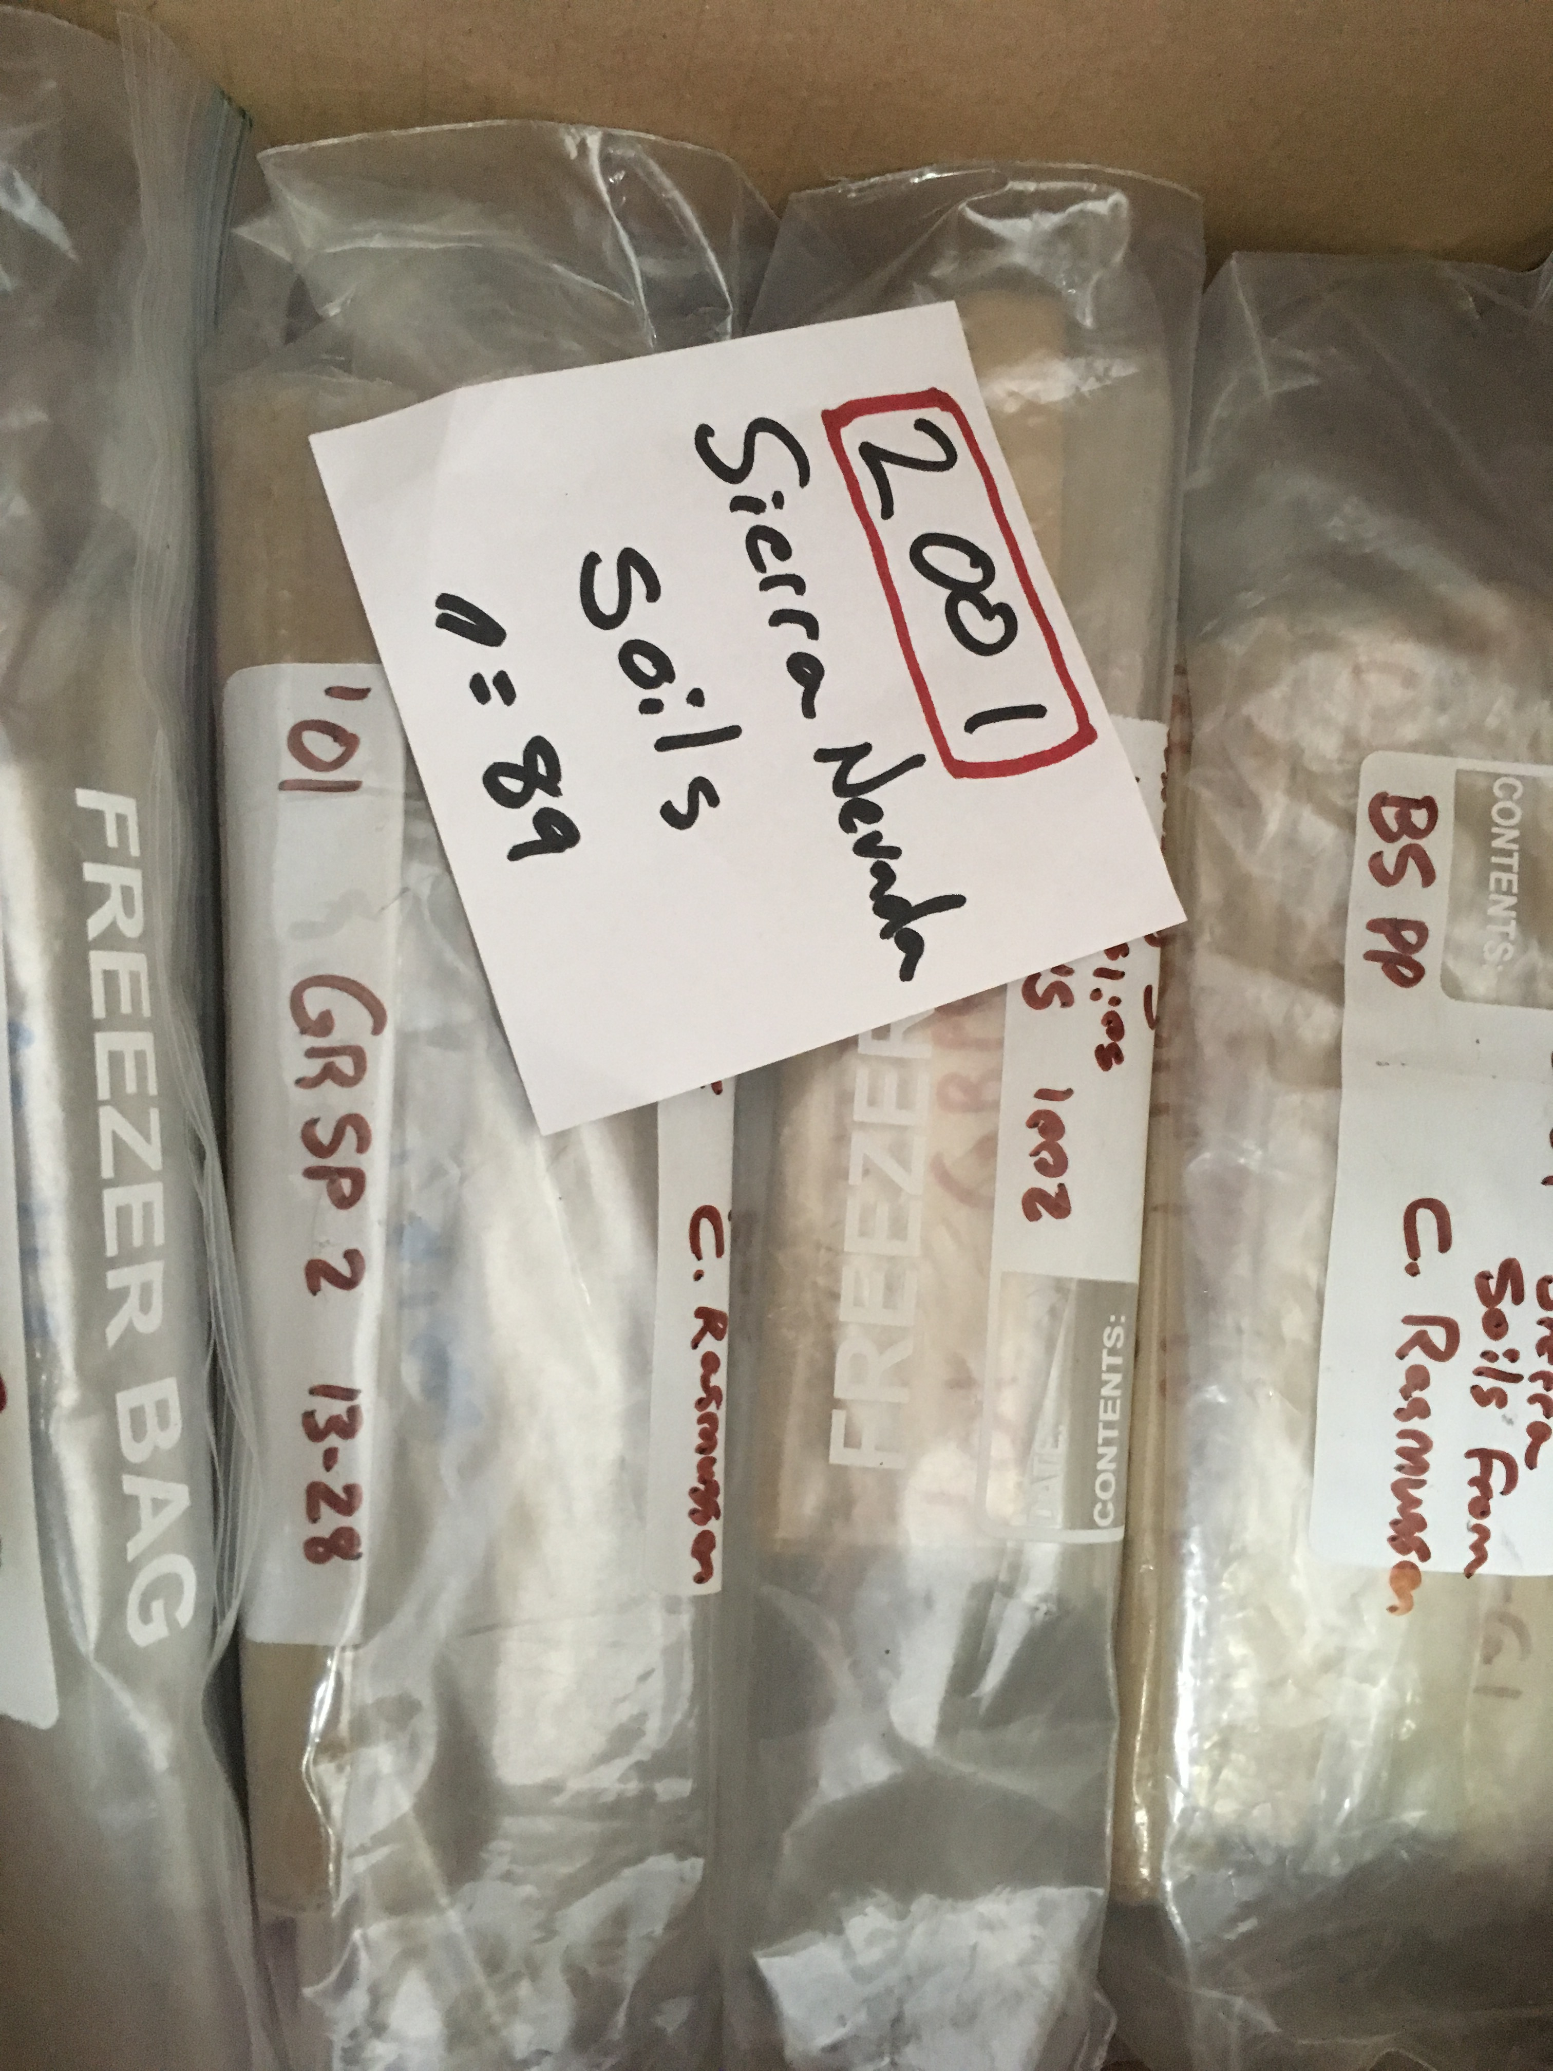
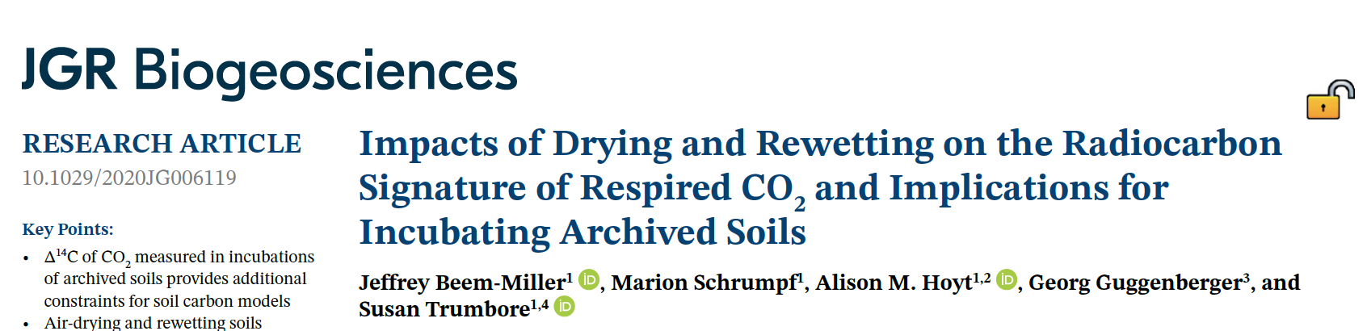
STUDY SITES
9 sites
3 sampling years (2001, 2009, 2019)
3 depths (0-0.1 m, 0.1-0.2 m, 0.2-0.3 m)
Analyses:
%C and %N
density fractions (free light, occluded light, heavy)
∆¹⁴C (bulk soil, respired CO2, density fractions)
Basalt
Andesite
Granite
100 km
Notes:
density fractionation in order to quantify the mineral associated soil organic matter pool
Time series of respired CO2 and bulk soil C 14C are key constraints for the soil carbon modeling work I did

Slide 32
STUDY SITES
9 sites
3 sampling years (2001, 2009, 2019)
3 depths (0-0.1 m, 0.1-0.2 m, 0.2-0.3 m)*
Analyses:
%C and %N
density fractions (free light, occluded light, heavy)
∆¹⁴C (bulk soil, respired CO2, density fractions)
Additional data (Rasmussen et al.):
selective dissolution
clay mineralogy
Basalt
Andesite
Granite
100 km
cf. Rasmussen 2004; Rasmussen et al., 2006; 2007; 2008; 2010; 2018

Slide 33

THE RADIOCARBON TRACER
¹⁴C
Notes:
1) rare isotope, 1 in 1 trillion atoms of carbon in the pre-industrial atmosphere, and
2) radioactive

Slide 34
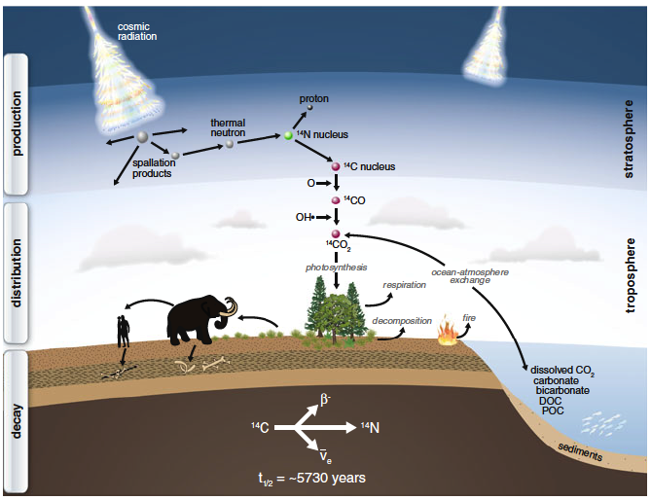
THE RADIOCARBON TRACER
¹⁴C
(figure from Schuur et al., 2016)
Notes:
Radiocarbon is naturally produced in the stratosphere by high energy incoming cosmic rays, and as soon as this atmospheric carbon is fixed, such as by a plant, it begins to decay, with a half-life around 6000 years.
Because of this relatively long half life, this technique of radiocarbon dating is useful on centennial and longer time scales

Slide 35
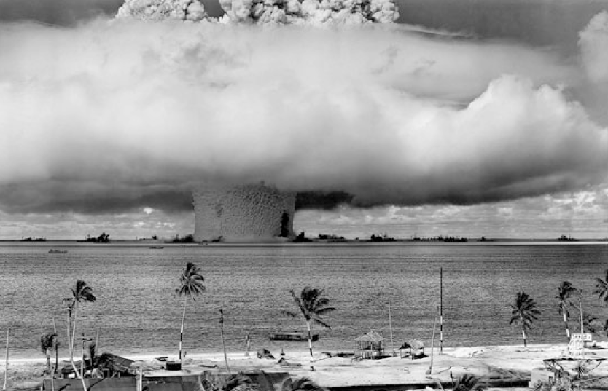
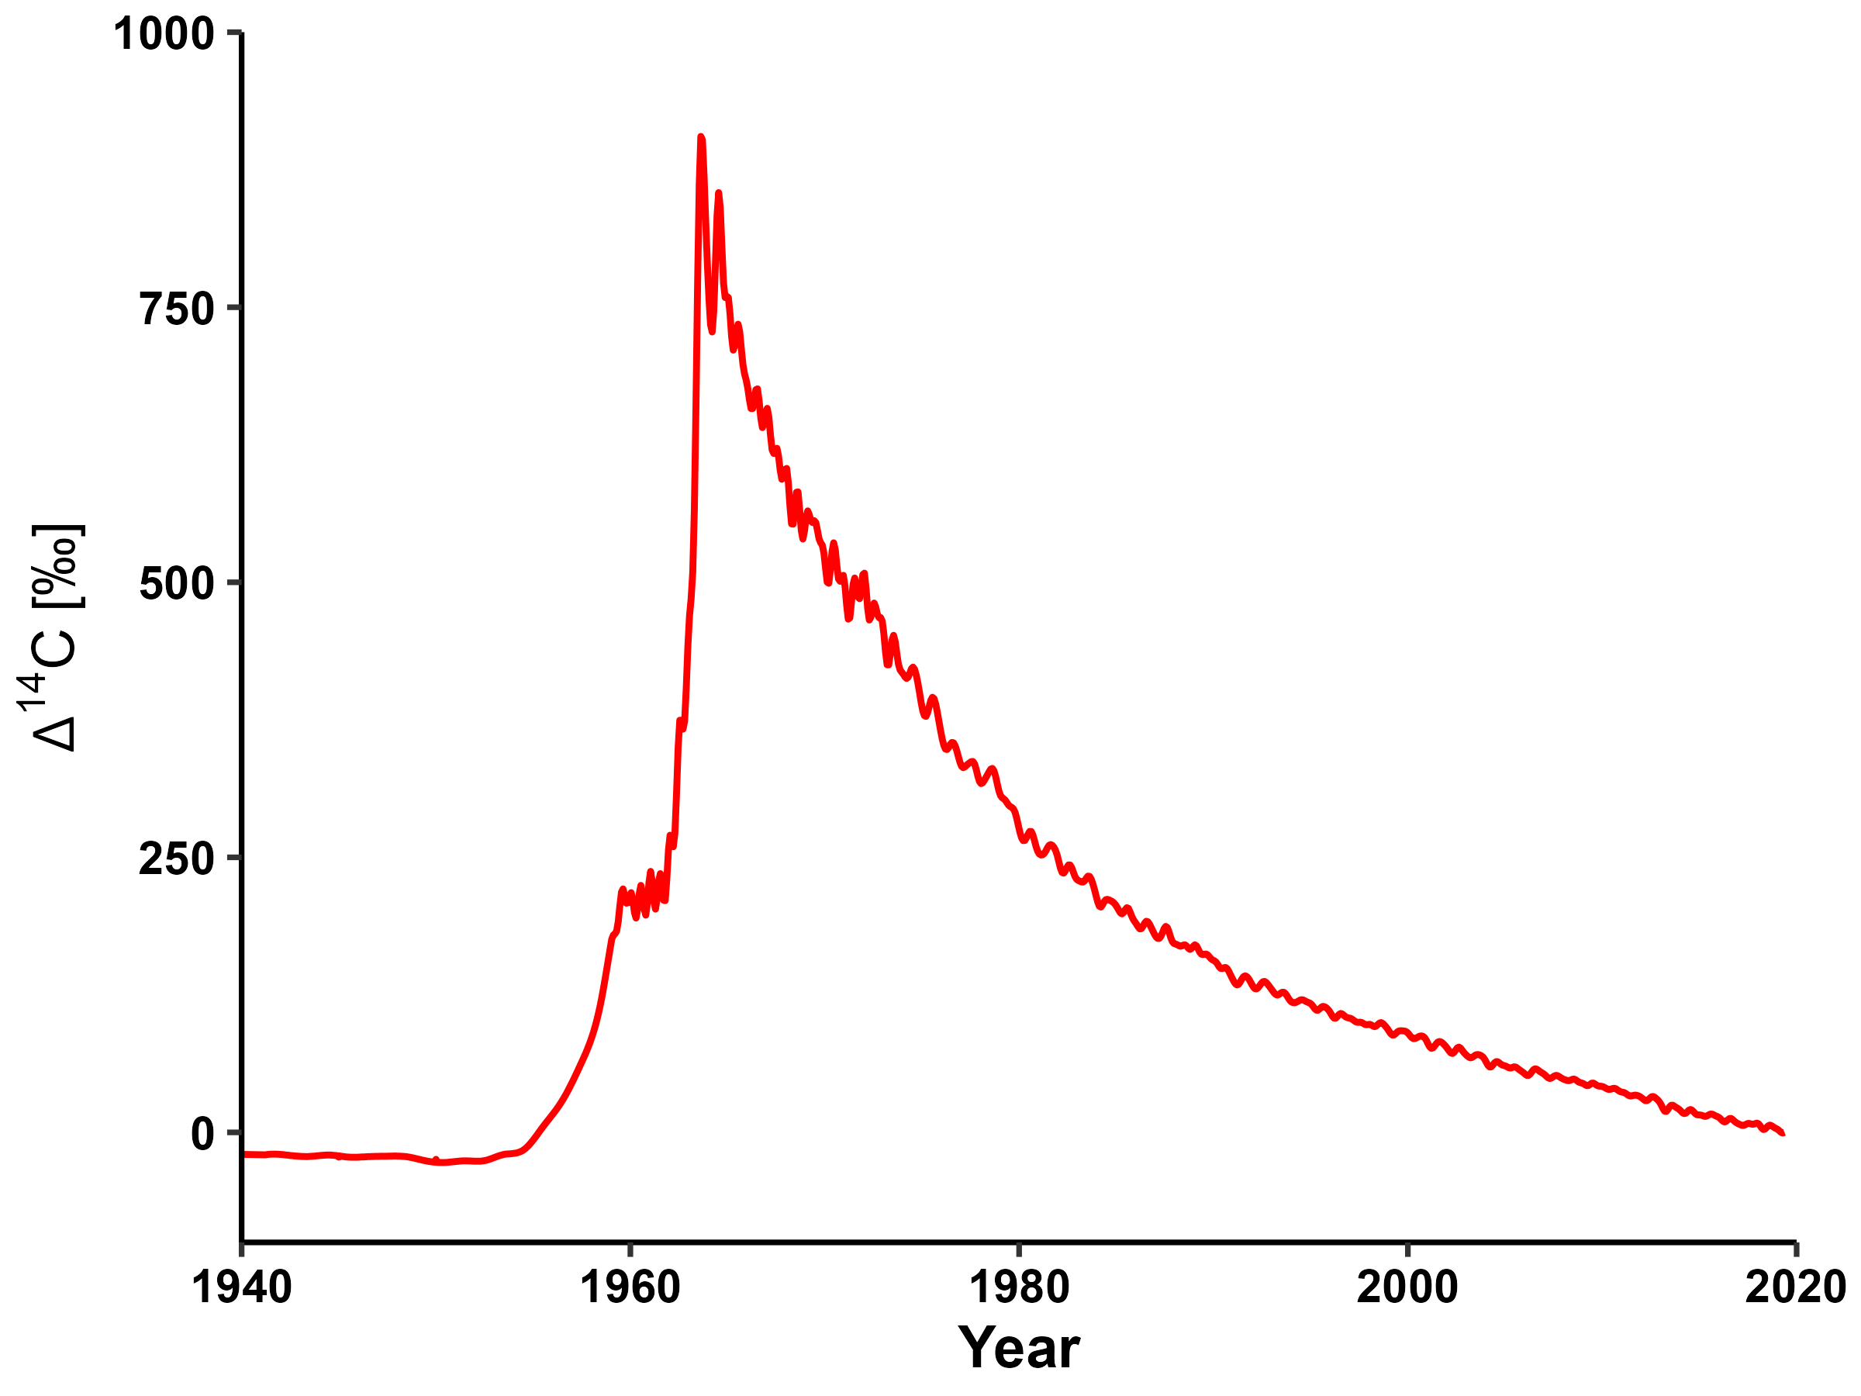
THE RADIOCARBON TRACER
(figure from S. von Fromm)
Notes:
2nd source of 14C: nuclear weapons testing
2x 14C atmosphere prior to testing ban in ’64
concentration declines via uptake of bomb-C label
rapid rate of decline enables dating of organic C w/ annual resolution

Slide 36
THE RADIOCARBON TRACER
“bomb-C” useful for tracing soil C cycling on short (1-10¹) time scales
cosmogenic ¹⁴C useful for time scales >10²
(figure from S. von Fromm)
Notes:
So to sum up:

Slide 37

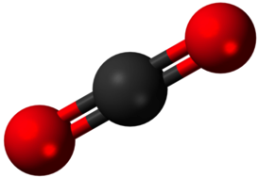
COMPARTMENTAL MODELS
IN
OUT
Notes:
Soil is an open system:
constant input & output
need a model to interpret 14C

Slide 38
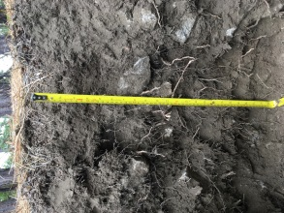
COMPARTMENTAL MODELS
IN
Bulk soil ∆¹⁴C
~
Respired ∆¹⁴C-CO₂
~
OUT
age
transit time
soil C age: age of particles in the soil
soil C transit time: age of particles in the release flux
Notes:
bulk soil 14C ~ mean age soil C
respired 14C ~ age of carbon leaving the soil = transit time

Slide 39
COMPARTMENTAL MODELS
Bulk soil ∆¹⁴C
~
IN
Respired ∆¹⁴C-CO₂
~
OUT
FAST
age
transit time
SLOW
out
C-mass weighted
C-flux weighted
Notes:
Soils are heterogeneous, i.e., multiple pools turning over at different rates
bulk soil 14C ≠ respired 14C

Slide 40
COMPARTMENTAL MODELS
IN
OUT
FAST
SLOW
out
Notes:
From a modeling perspective, we can represent this system with three parameters

Slide 41
COMPARTMENTAL MODELS
IN
2-pool parallel
OUT
FAST
k1
Out
SLOW
In
𝛾
out
k2
Notes:
turnover rates for each pool:
k1, k2
gamma, i.e., proportion of inputs allocated to each pool

Slide 42
COMPARTMENTAL MODELS
IN
2-pool parallel
OUT
FAST
k1
Out
SLOW
In
𝛾
out
k2
+ Lag
Notes:
fourth parameter = lag time
carbon entering the system is “pre-aged”
upper soil horizons or vegetation

Slide 43
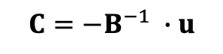
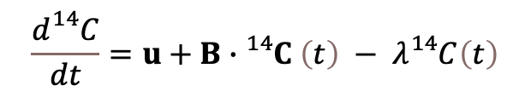
PARAMETER OPTIMIZATION
$$\frac{d{}_{}^{14}C}{dt}=u+B∙{}_{}^{14}C \left(t\right) − λ{}_{}^{14}{C\left(t\right)}$$
Approach:
SoilR
steady-state (input = output)
$$C={−B}^{−1} ∙u$$
SoilR: Sierra et al., 2014
Notes:
compartmental model represented as a system of linear differential equations
SoilR
steady-state assumption assumed
No notable changes in SOC stocks or C concentrations between 2001 and 2019

Slide 44
PARAMETER OPTIMIZATION
Approach:
SoilR
steady-state (input = output)
Constraints:
∆¹⁴C time series (bulk soil & respired CO₂)

Slide 45
PARAMETER OPTIMIZATION
Approach:
SoilR
steady-state (input = output)
Constraints:
∆¹⁴C time series (bulk soil & respired CO₂)
Optimization:
initial analytical algorithm fit
10,000 MCMC runs
AIC to select best-fit model
solve for inputs with known stocks
Notes:
Markov Chain Monte Carlo simulation
robust
uncertainty of parameter estimate
NB: considered alternate model structures, but selected the 2-pool parallel die to superior fit and simplicity
Able to estimate inputs due to steady-state assumption and measured stocks
This is not trivial because belowground inputs are hard measure empirically

Slide 46
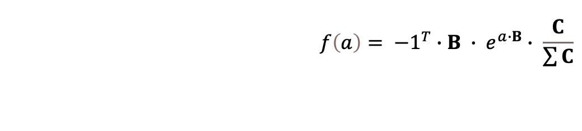
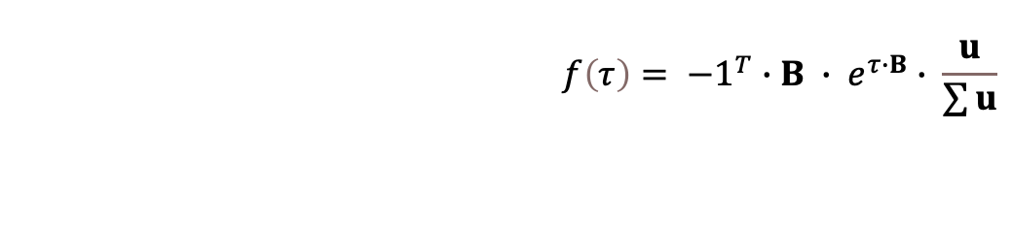
AGES & TRANSIT TIMES
Probability distribution functions:
Age
Transit time
$$f\left(a\right)= {−1}^{T}∙B ∙ e^{a∙B}∙ \frac{C}{\sum{C}}$$
$$f\left(τ\right)= {−1}^{T}∙B ∙ e^{τ∙B}∙ \frac{u}{\sum{u}}$$
See Metzler et al., 2018 for derivation of these formulae
Notes:
probability distributions for soil C age and transit time
key for understanding stochastic and dynamic nature of soil C
distributions represent heterogeneity of the system (multiple pools)

Slide 47
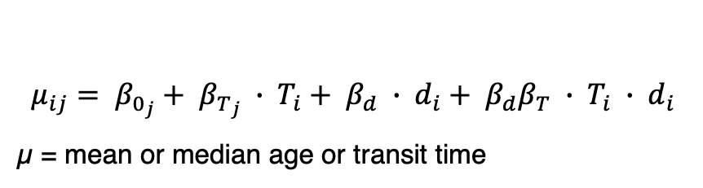
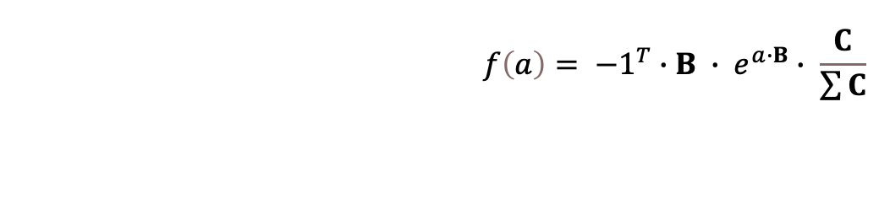
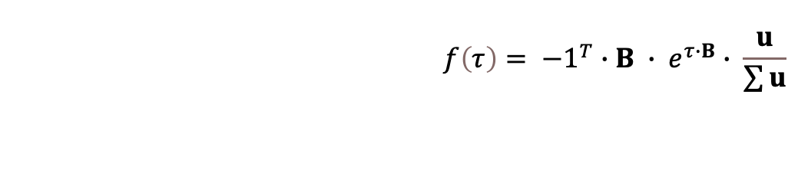
AGES & TRANSIT TIMES
Probability distribution functions:
Age
Transit time
Generalized Bayesian linear models:
$$f\left(a\right)= {−1}^{T}∙B ∙ e^{a∙B}∙ \frac{C}{\sum{C}}$$
$$f\left(τ\right)= {−1}^{T}∙B ∙ e^{τ∙B}∙ \frac{u}{\sum{u}}$$
$$μ_{ij}= β_{0_{j}}+ β_{T_{j}} ∙ T_{i}+ β_{d} ∙ d_{i}+ β_{d}β_{T} ∙ T_{i} ∙ d_{i}$$
µ = mean or median age or transit time
Covariates:
T (mean annual temperature)
d (depth)
OX (reactive minerals)
Notes:
generalized Bayesian linear modeling framework
relationship between ages and transit times and temperature and soil mineralogy
[allowed me to use the variance observed in ages and transit times from the MCMC runs to inform the model priors]
[posterior distribution of the linear model parameters also improves uncertainty estimates for sparse datasets]

Slide 48
RESULTS:
Ages & transit times
Notes:
OK, so now I will go over the bulk and respired 14C time series data, as well as the relationship of temperature and soil mineralogy to soil carbon ages and transit times

Slide 49
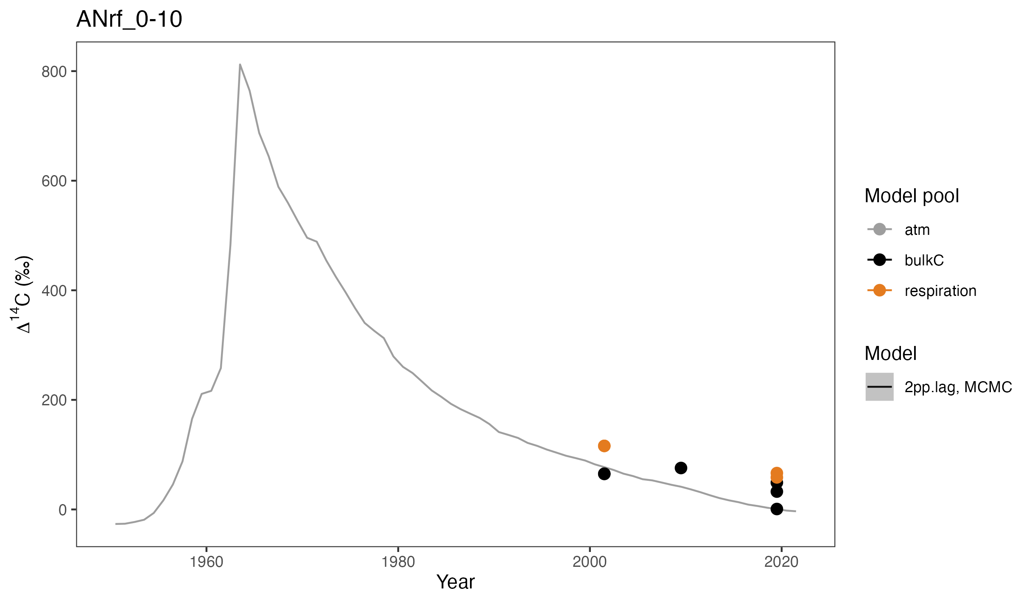
RADIOCARBON TIME SERIES
Notes:
Example of time series data (cold climate andesite, 0-10cm)
bomb-C curve in background

Slide 50
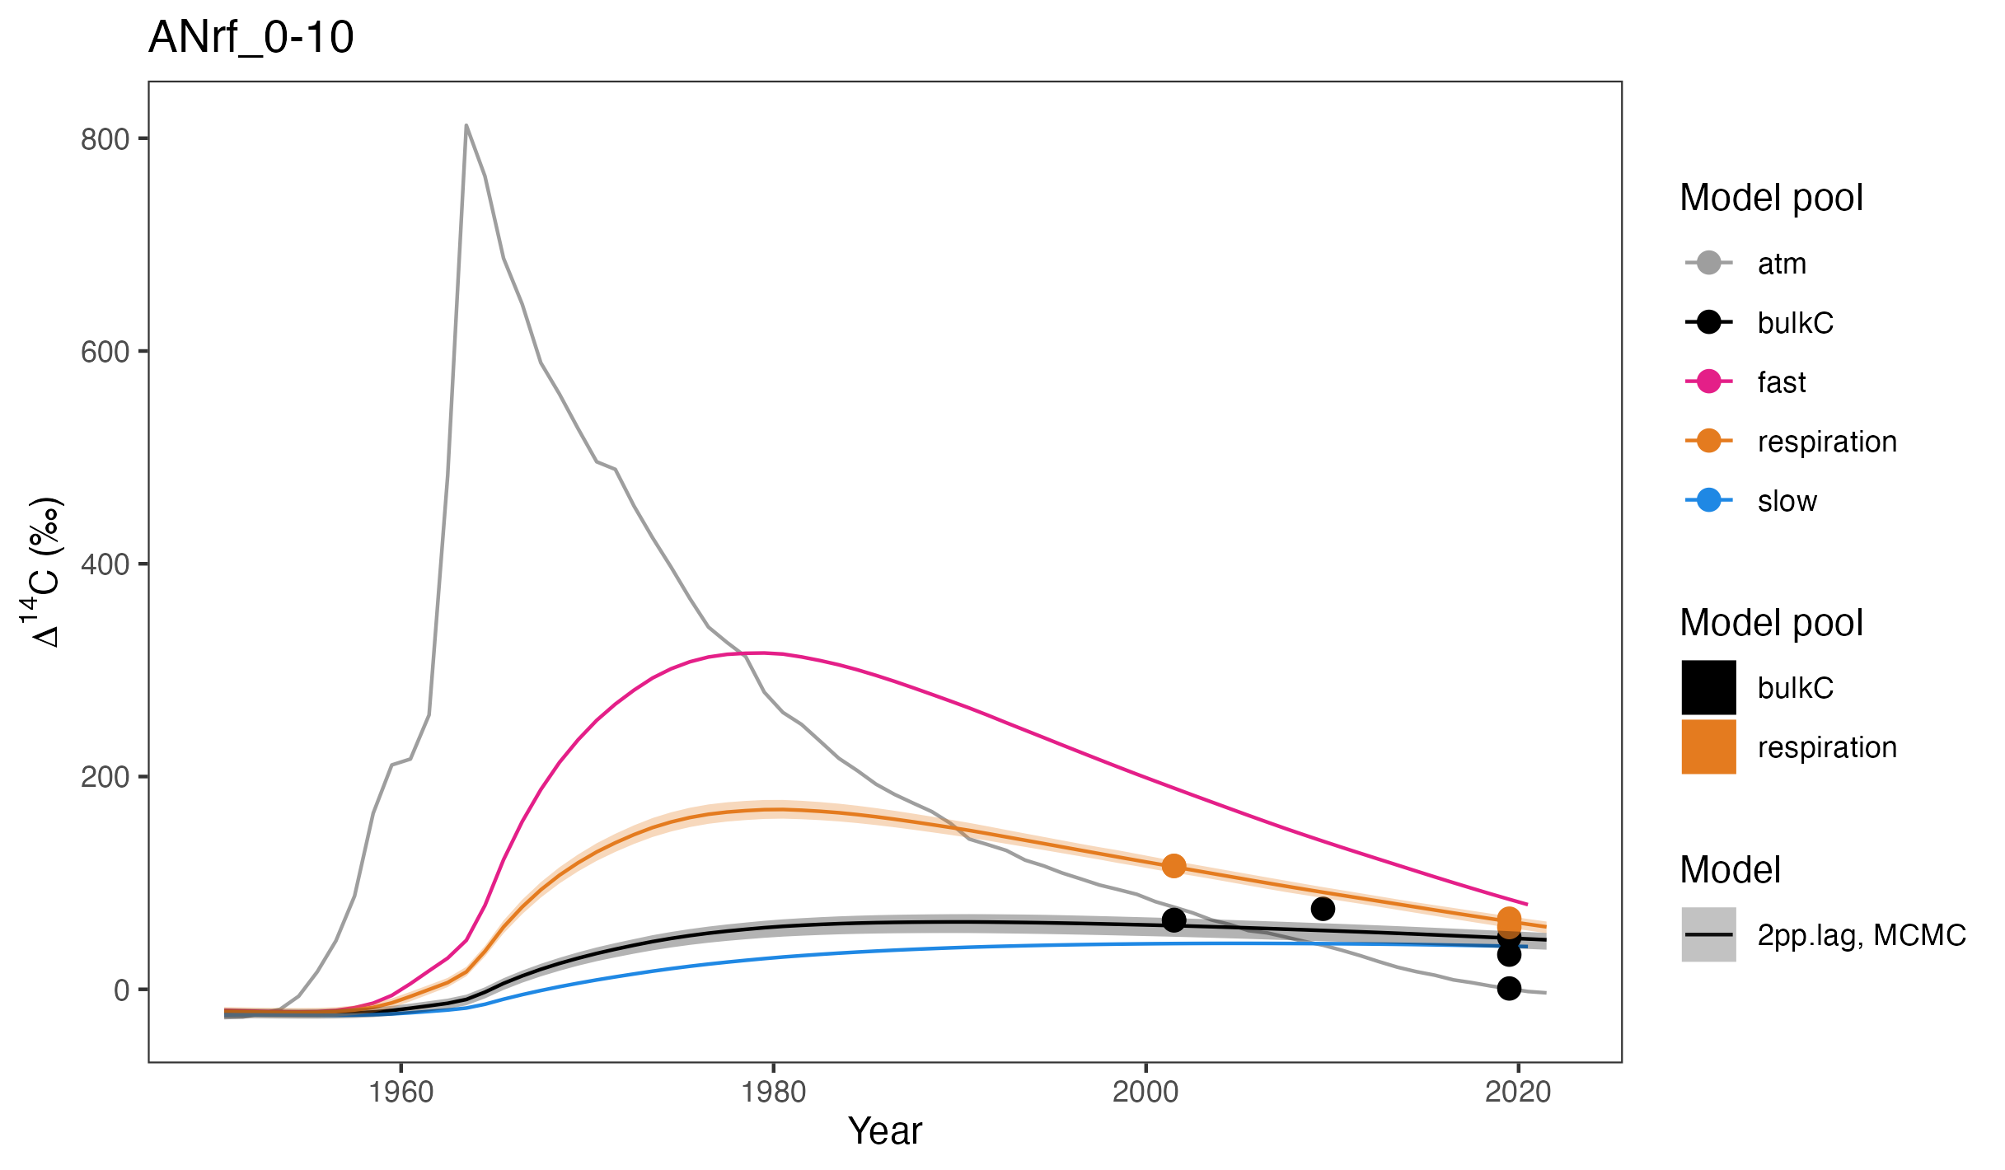
RADIOCARBON TIME SERIES
Notes:
Pretty good fit
true for most sites
Discussion:
1) bulk and respired 14C data
2) model estimates for ages and transit times
3) interpretation of the pool dynamics---shown here in pink and blue

Slide 51
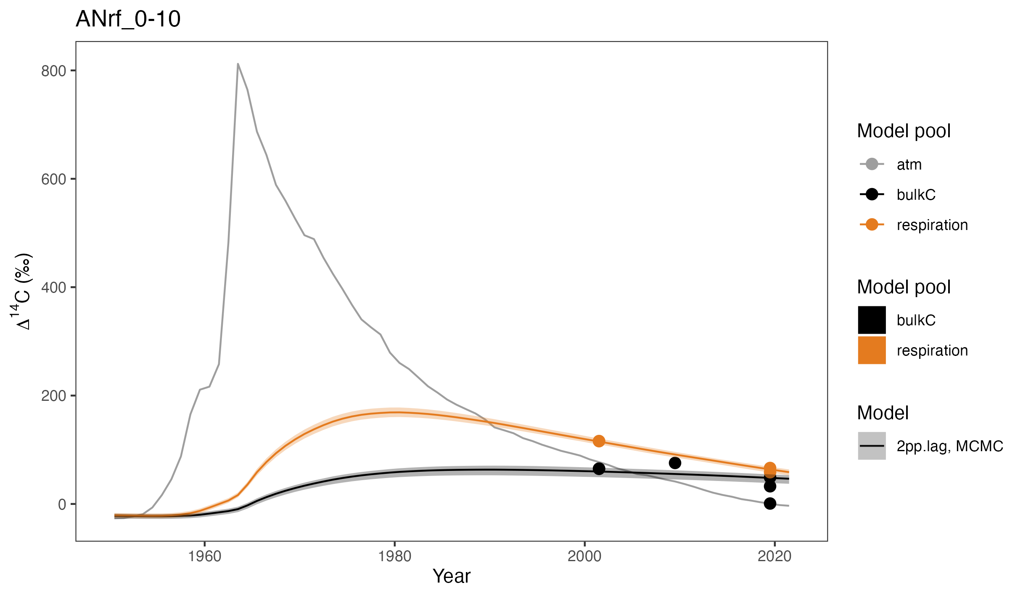
RADIOCARBON TIME SERIES
Notes:
To orient you, just a heads-up that for the next few slides I will be zooming in on this time period here---from 2001 to 2019

Slide 52
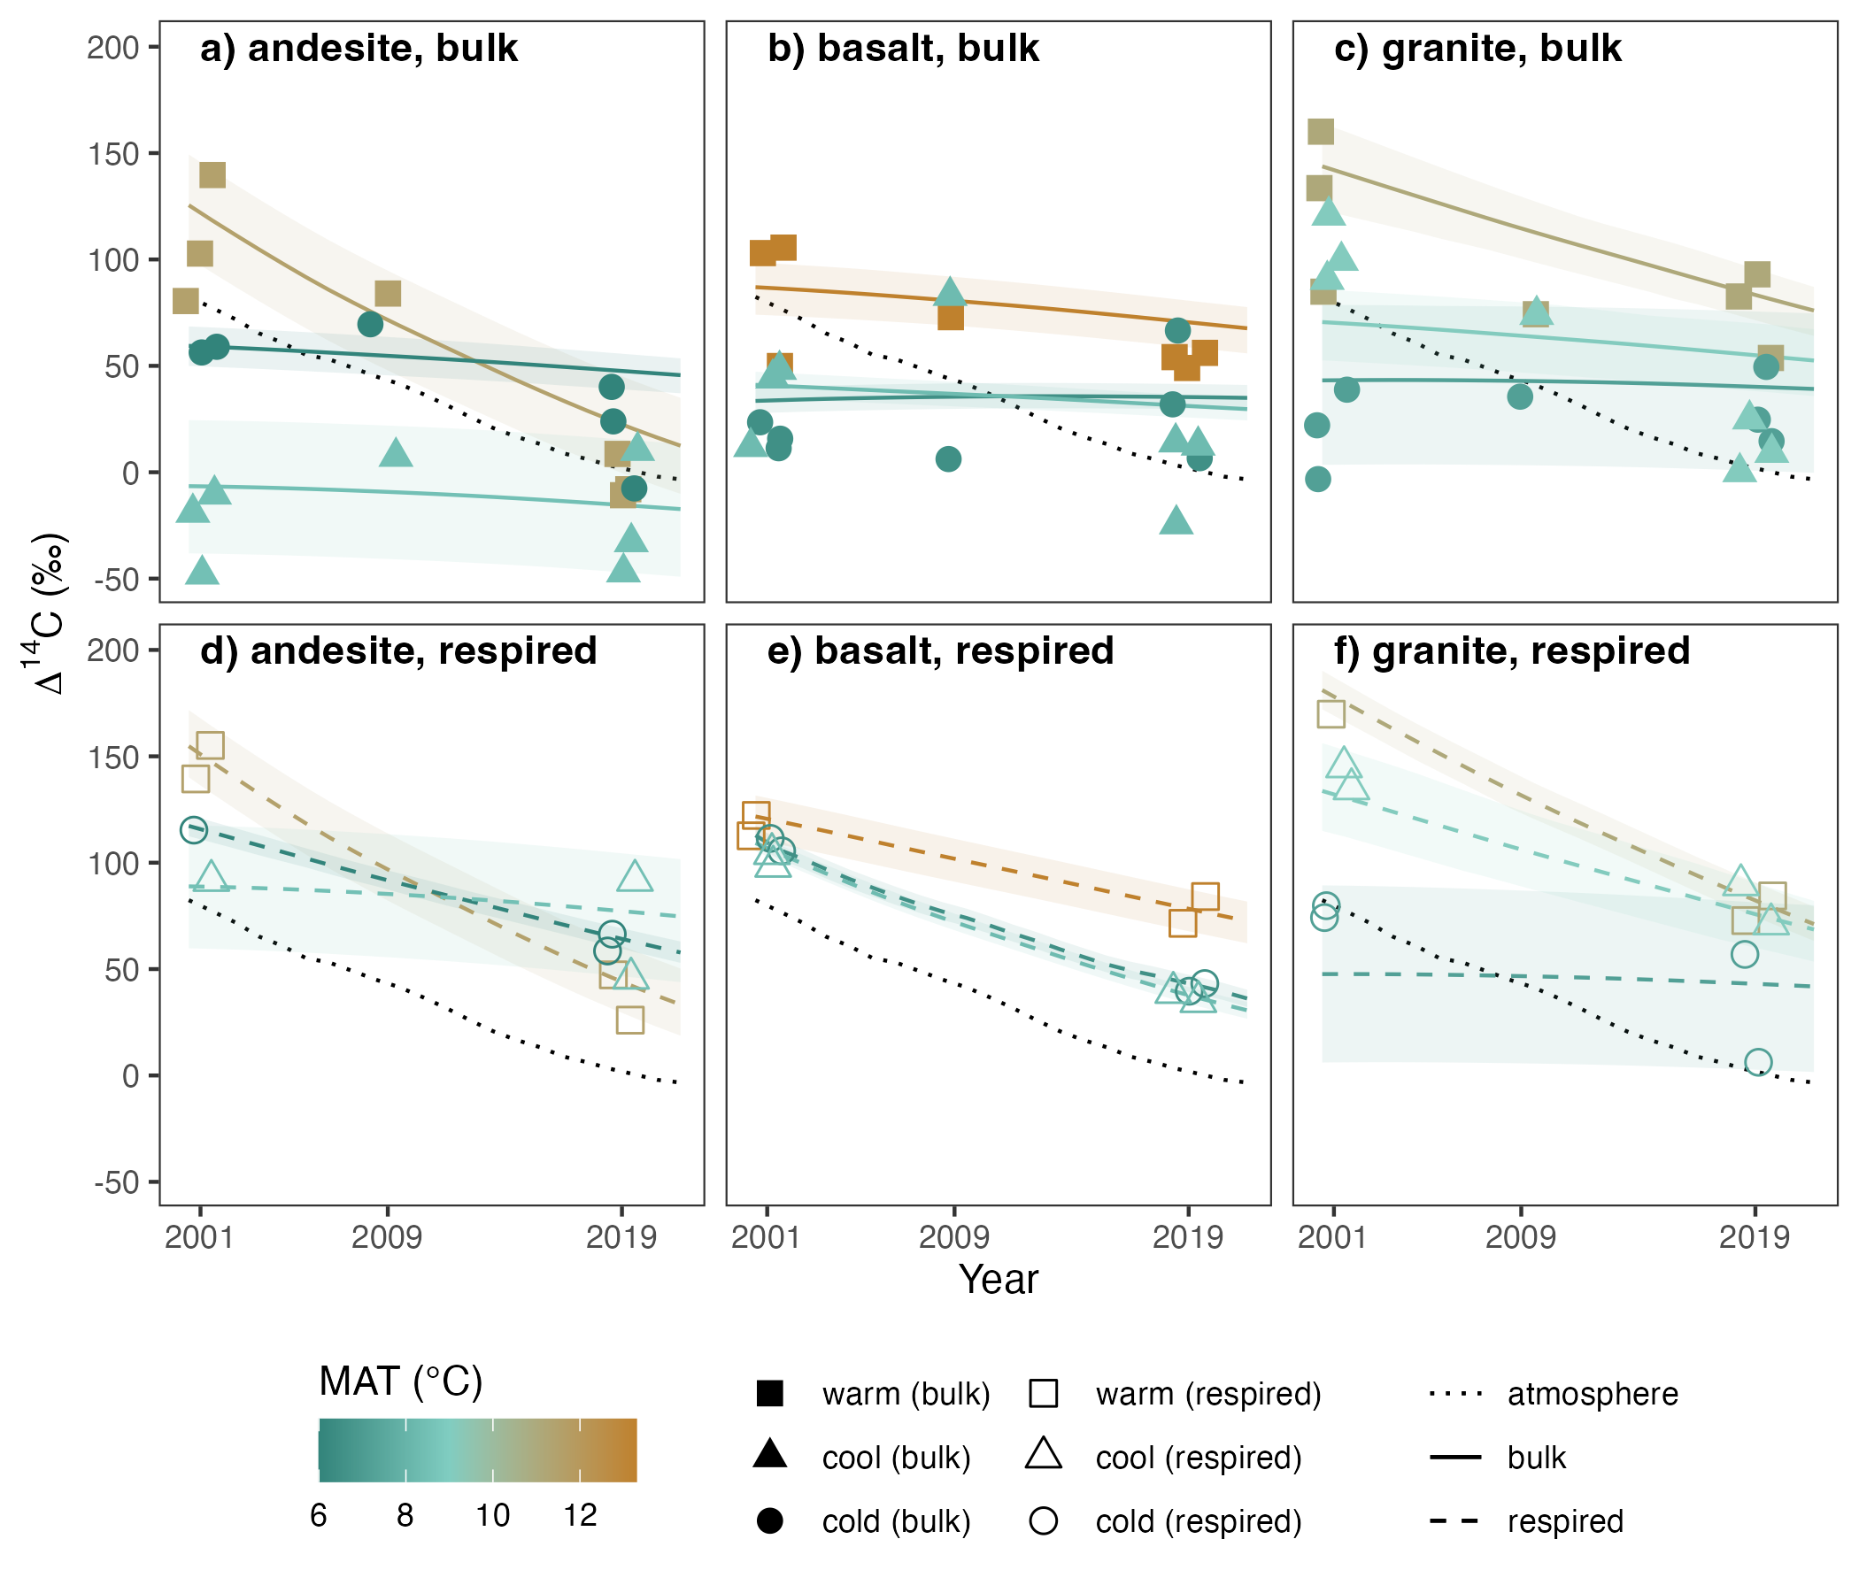
BULK SOIL ∆¹⁴C
0-0.1 m
∆¹⁴C
Notes:
OK, so let’s start with bulk soil 14C
(explain axes, lines, etc.)
Andesite:
trajectory of bulk soil 14C varies by climate: warm > cool ~ cold
absolute ∆14C: cool < cold < warm
cold site ∆14C trajectory flat, but absolute ∆14C > 0: bomb-C = decadally cycling C

Slide 53
BULK SOIL ∆¹⁴C
0-0.1 m
∆¹⁴C
Notes:
Basalt:
minimal change over time
cool C much younger (bomb-C enriched)
cool = cold

Slide 54
BULK SOIL ∆¹⁴C
0-0.1 m
∆¹⁴C
Notes:
Granite:
expected climate relationship for ∆14C: warm > cool > cold
true for trajectory & absolute ∆14C

Slide 55
BULK SOIL ∆¹⁴C
0-0.1 m
∆¹⁴C
Parent material affects the temperature sensitivity of bulk ∆¹⁴C
Greatest differences among parent materials seen at the cool climate sites
Notes:
So to summarize, we can say that parent material affects temperature sensitivity of bulk soil ∆¹⁴C, and also that we see the greatest differences among parent materials at the cool climate sites, so there’s something special going on there

Slide 56
RESPIRED ∆¹⁴C-CO₂
0-0.1 m
∆¹⁴C
Notes:
Andesite:
fastest rate of change is seen in the warm climate soils
slope of this change = atmosphere slope, suggesting a strong contribution of annually cycling soil carbon
least change for cool climate soils, similar to the bulk soil
But unlike bulk soil 14C, all ∆14C > 0, i.e., majority of C leaving soil is cycling on annual to decadal time scales

Slide 57
RESPIRED ∆¹⁴C-CO₂
0-0.1 m
∆¹⁴C
Notes:
Basalt:
much less variation with climate in terms of both the slopes and the actual ∆14C values
rate of decline only slightly slower than what we observe in the atmosphere across climate zones

Slide 58
RESPIRED ∆¹⁴C-CO₂
0-0.1 m
∆¹⁴C
Notes:
Granite:
expected temperature response, with change over time and absolute ∆14C values decreasing with decreasing temperature

Slide 59
RESPIRED ∆¹⁴C-CO₂
0-0.1 m
Parent material affects the temperature sensitivity of respired ∆¹⁴C
∆¹⁴C
Notes:
So to summarize, we can say that just as with bulk soil 14C, parent material also appears to affect the temperature sensitivity of respired 14C

Slide 60
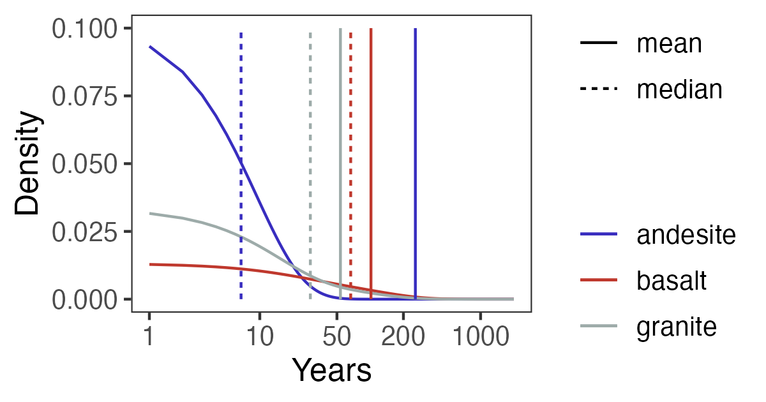
PROBABILITY DISTRIBUTIONS
a) warm, age
0-0.1 m
Notes:
what does it mean to have a probability distribution of soil C age or transit time?
median age < mean age
take-away:
mean is skewed
median describes central tendency of the data

Slide 61
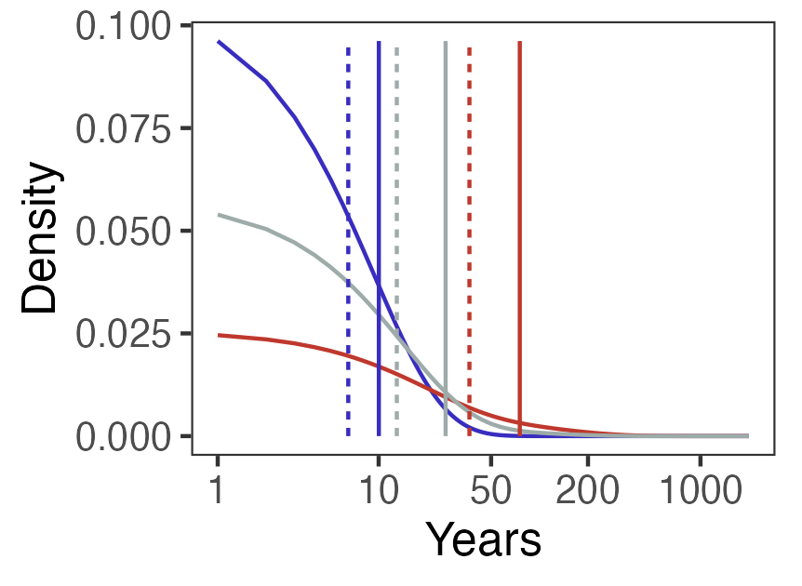
PROBABILITY DISTRIBUTIONS
b) warm, transit time
0-0.1 m
Notes:
Transit time:
like age, median < mean
Considering age and transit time:
andesite soil dominated by young carbon cycling on sub decadal timescales, with a small amount of very old C
basalt soil more homogenous and cycling more slowly, i.e., transit time ~ age
[median TT = time taken for 50% of inputs in a given year to be respired]

Slide 62
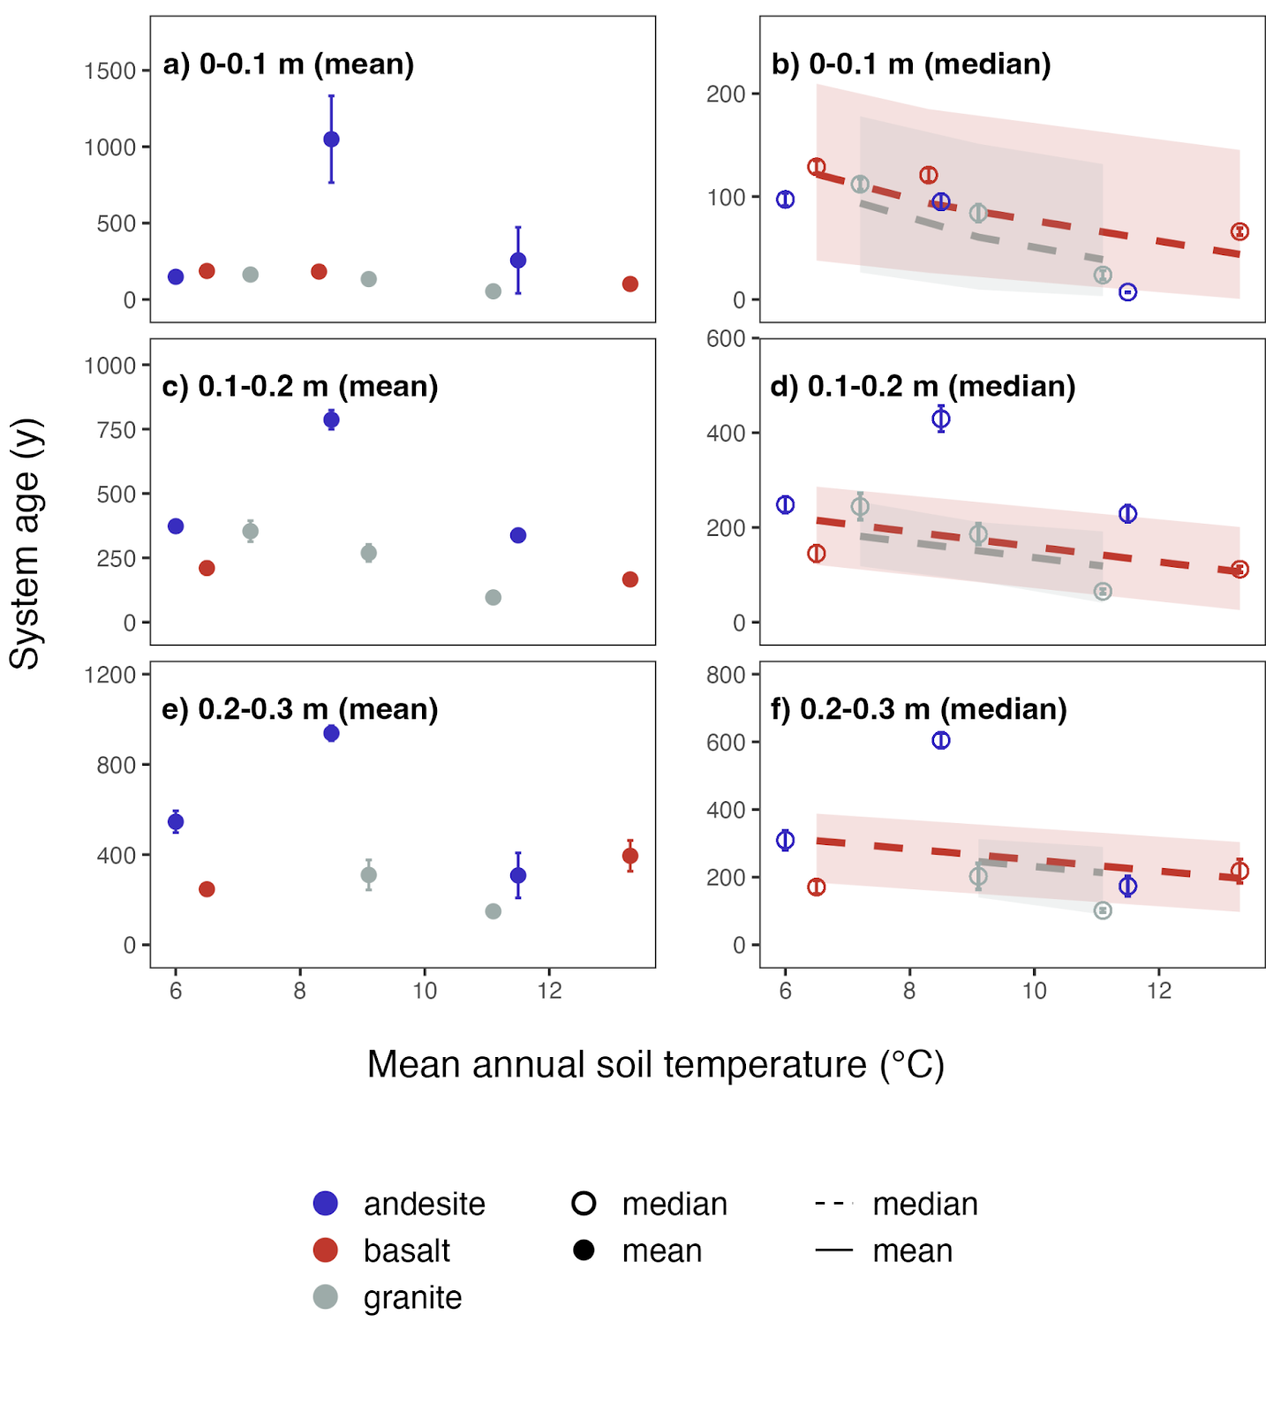
TEMPERATURE & SYSTEM AGE
age (y)
Notes:
OK, so now let’s look at how these mean and median ages and transit times relate to temperature and mineralogy

Slide 63
TEMPERATURE & SYSTEM AGE
age (y)

Slide 64
TEMPERATURE & SYSTEM AGE
Mineralogical factors more important than temperature for predicting mean system C ages
Median system C age more responsive to temperature than mean
Notes:
i.e., actively cycling C is more temperature sensitive than old stabilized C

Slide 65
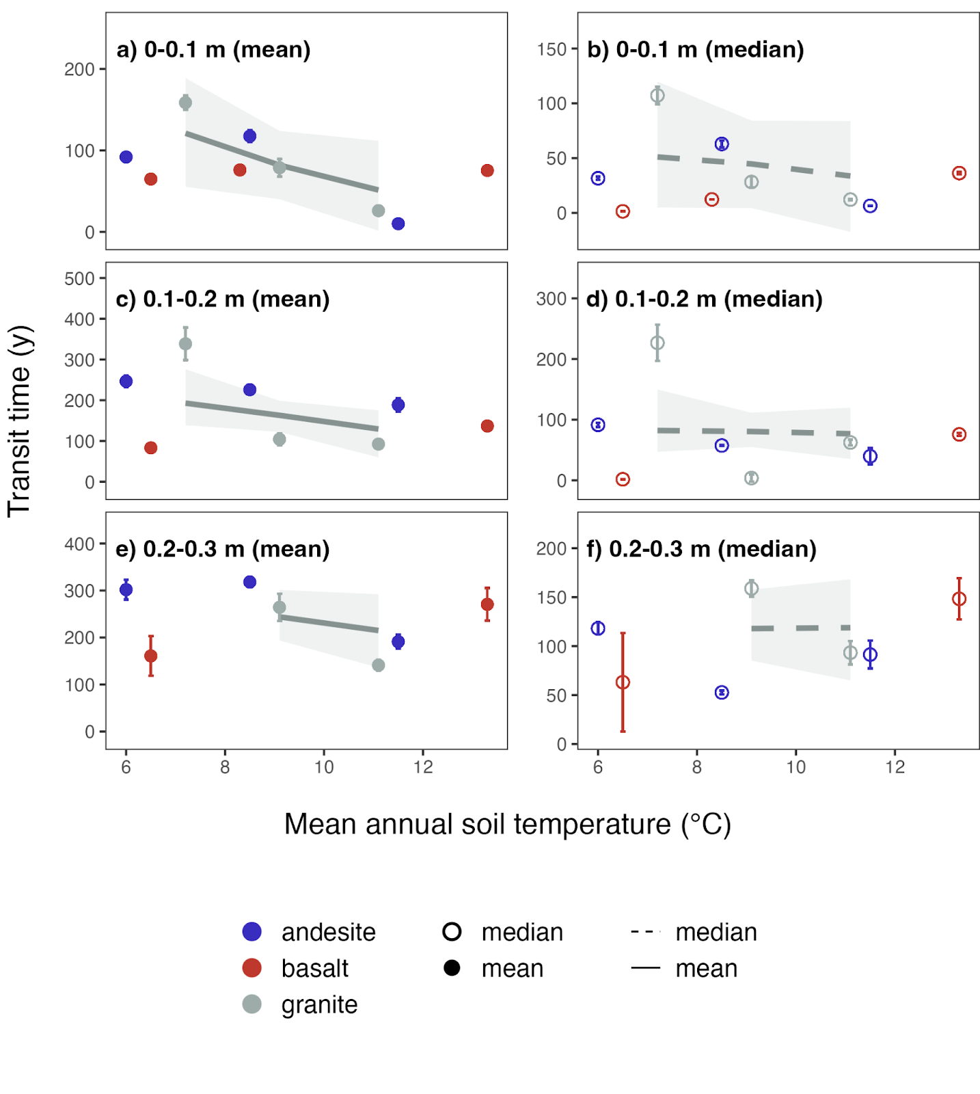
TEMPERATURE & TRANSIT TIME
transit time (y)

Slide 66
TEMPERATURE & TRANSIT TIME
transit time (y)

Slide 67
TEMPERATURE & TRANSIT TIME
Parent material has strong effect on temperature sensitivity of transit time
Expected relationship between temperature and transit time only apparent in granitic soils
transit time (y)

Slide 68
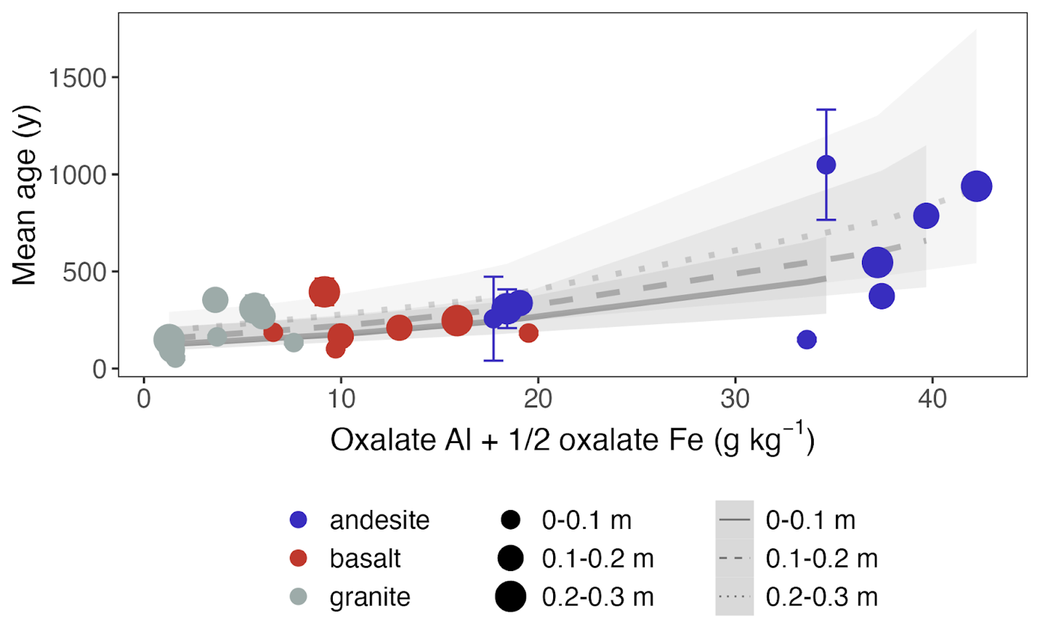
MINERALS & SYSTEM AGE
Notes:
mean age strongly correlated with oxalate extractable Al and Fe
proxy for SRO iron and aluminum oxyhydroxides
Strength of relationship increases with depth:
1) Proportion of total layer carbon partitioned to the heavy fraction also increases with depth
2) Relative impact of temperature buffered deeper in the soil---winter is not as cold, summer is not as hot
relationship w/ median age similar

Slide 69
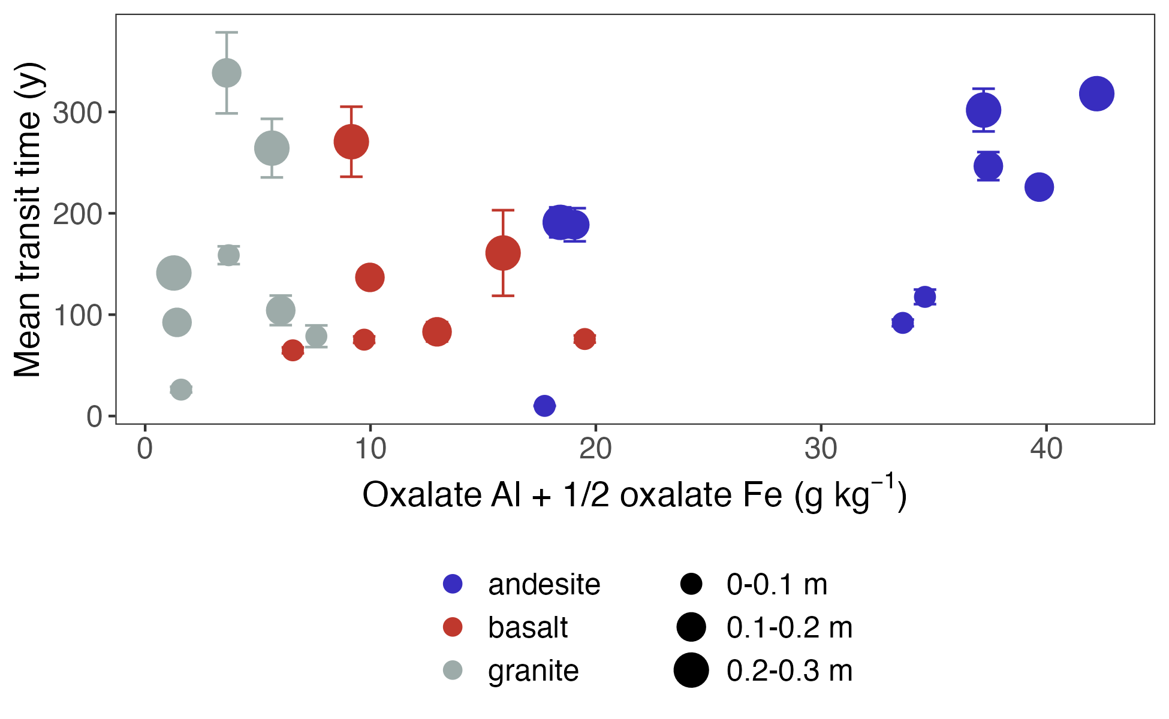
MINERALS & TRANSIT TIME
Notes:
When we look at transit time, however, we do not see a strong relationship with the oxalate extractable metal proxy

Slide 70
MINERALS & TRANSIT TIME
Notes:
However, if you squint, you can see that there is a trend for the basaltic and andesitic soils, at least if we ignore the surface soils (point out warm climate basalts)

Slide 71
MINERALS & TRANSIT TIME
Strong relationship between reactive mineral abundance and mean age
Relationship between oxalate extractable minerals and transit time weaker, and absent in surface and granitic soils
Notes:
However, if you squint, you can see that there is a trend for the basaltic and andesitic soils, at least if we ignore the surface soils (point out warm climate basalts)

Slide 72
RESULTS
Modellable vs.
Measurable
Notes:
For the next section of results I will talk about the density fraction data from the study sites, and address the conundrum of measuring the modellable and modeling the measureable

Slide 73
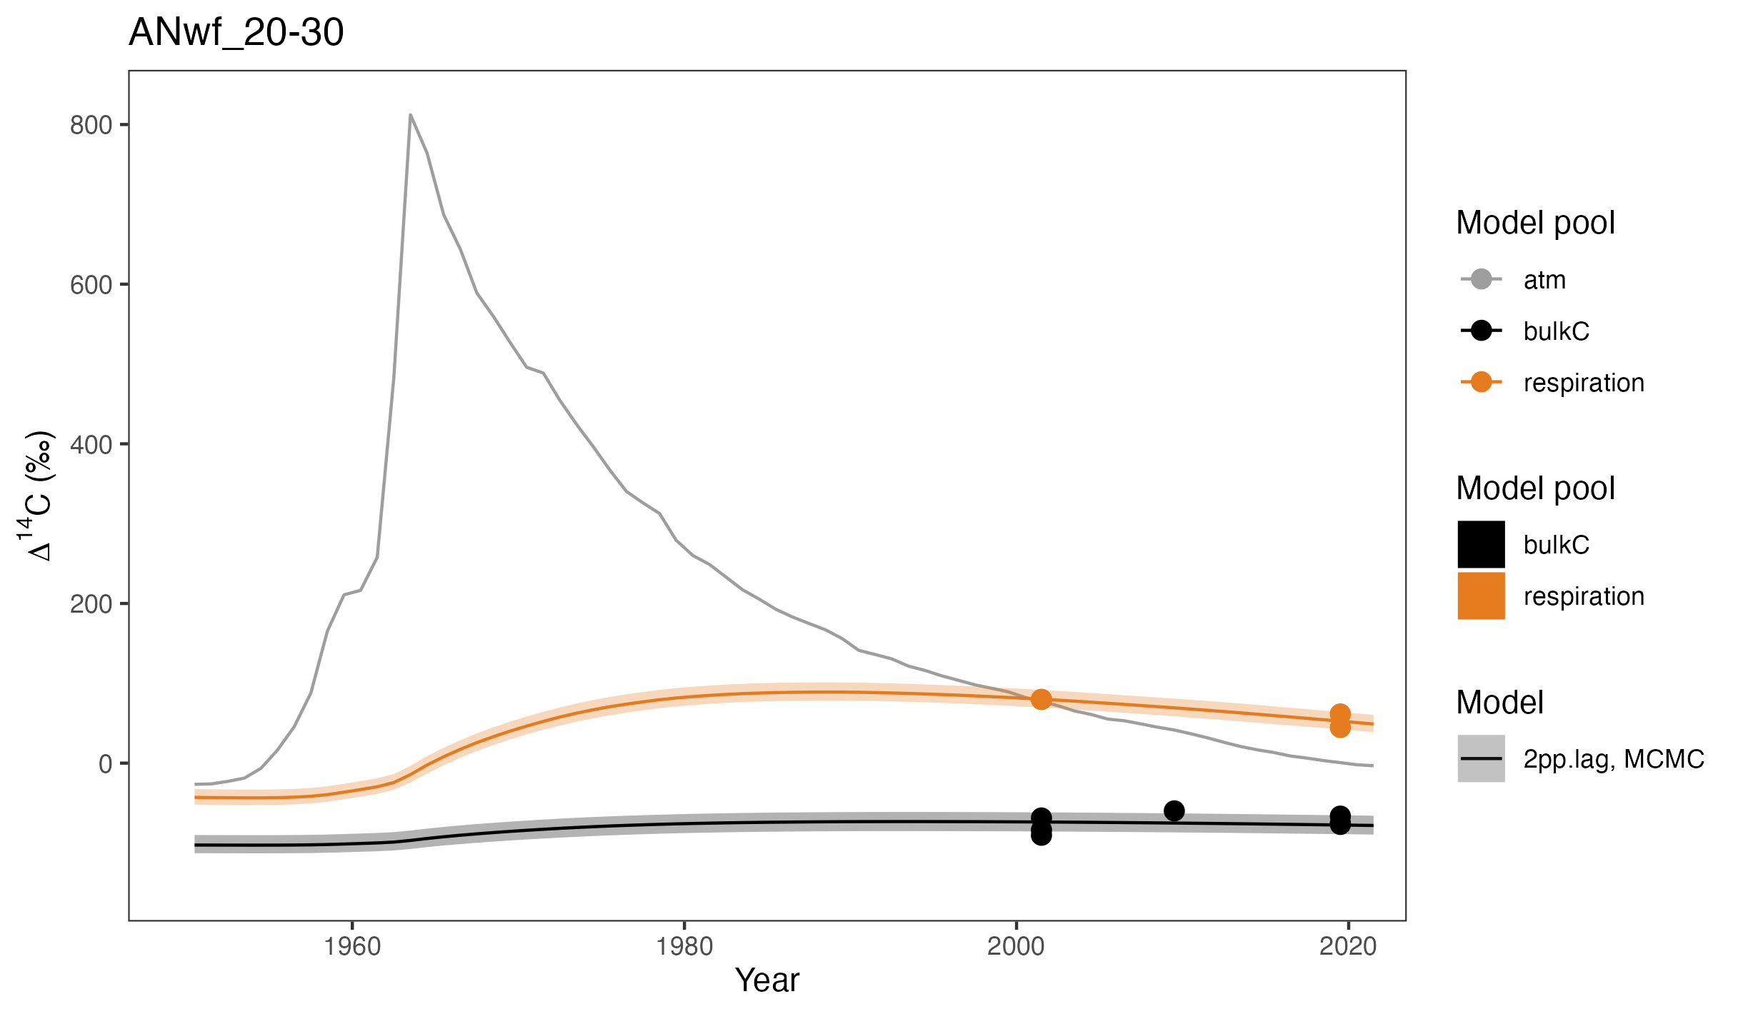
MODEL FIT + FRACTIONS
Cool climate andesite, 0.2-0.3 m
Notes:
OK, so let’s consider the 20-30 cm depth of the cool climate andesitic soil
As you can see, the 2-pool parallel model fits the data nicely
But what if we could use the fraction data to constrain the model pools?
Would this enable us to say something about the mechanisms of soil carbon persistence operating in the fast and slow model pools?

Slide 74
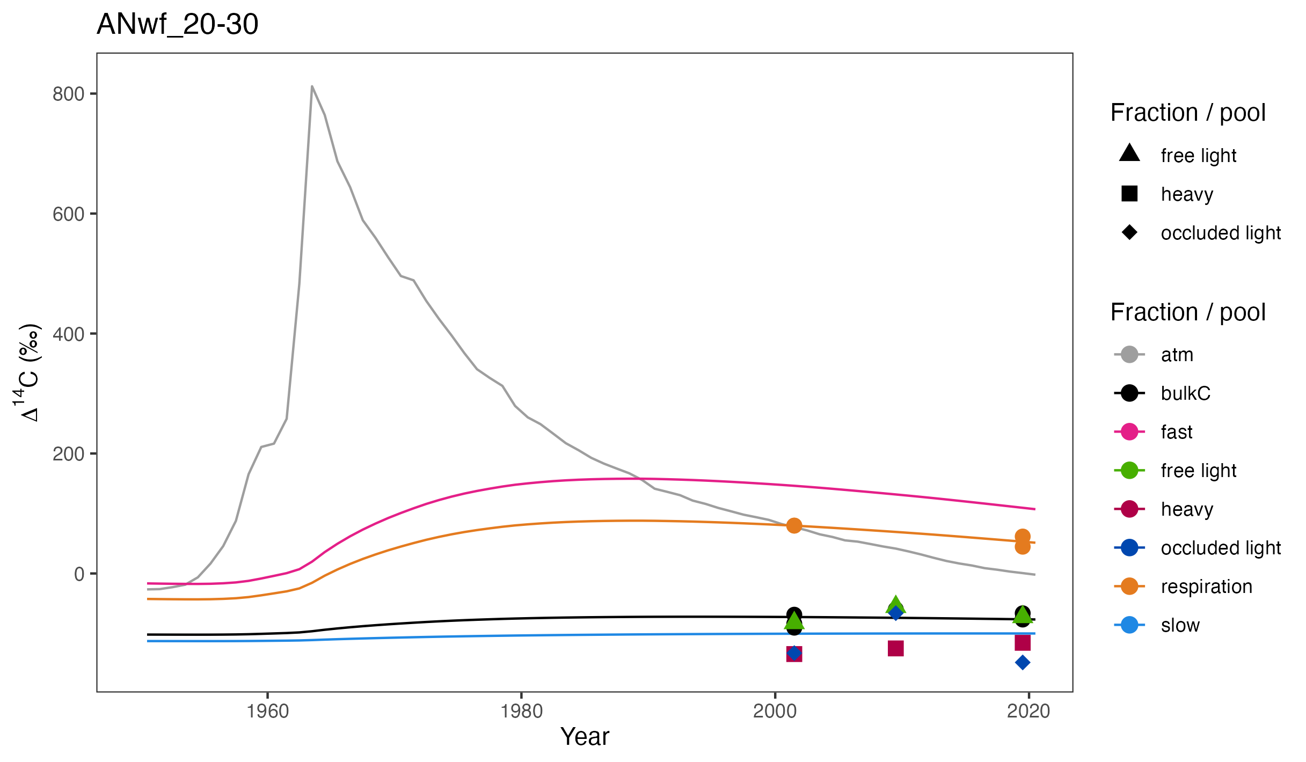
MODEL FIT + FRACTIONS
Cool climate andesite, 0.2-0.3 m
Notes:
Short answer is no.
Issues:
fast pool and respired 14C << free light
free light---green triangles--contain substantial amounts of charcoal
heavy fraction > “slow” pool [even more so at other sites/layers]
[The other reason that the light fraction is older than we might expect is that I think it contains some degree of mineral-associated organic matter
How is that possible? Well, as you can imagine, if a dense clay particle is loaded with enough low density organic matter, there will be a point at which it floats in the heavy solution that is used to separate the fractions → since I used a density of 1.8, this is likely the case]

Slide 75
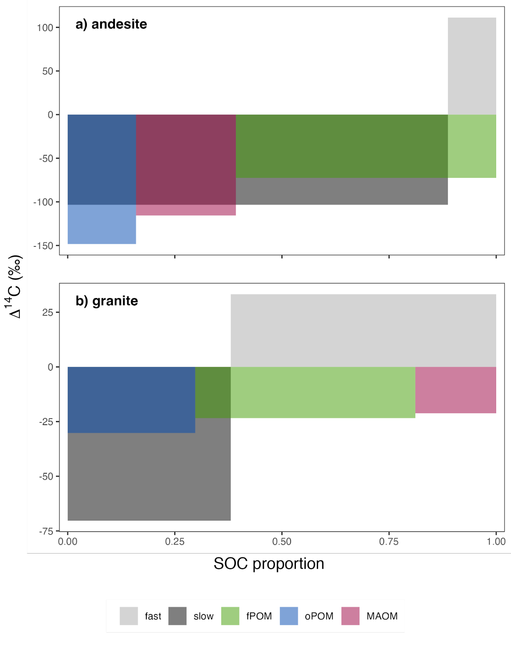
C/∆¹⁴C DISTRIBUTIONS
∆¹⁴C (‰)
Cool climate soils, 0.2-0.3 m, 2019
Notes:
overlay of C and ∆14C distributions of modeled pools and measured fractions
As we saw in the time series:
fractions fail to capture fast pool
slow pool is a mixture of all three fractions

Slide 76
C/∆¹⁴C DISTRIBUTIONS
∆¹⁴C (‰)
Cool climate soils, 0.2-0.3 m, 2019
Notes:
Granite even more poorly aligned
miss youngest carbon in fast pool
also miss oldest carbon in slow pool
Why? Skewed probability distributions!
From empirical point of view we can only observe this mean value
model provides full probability distribution function

Slide 77
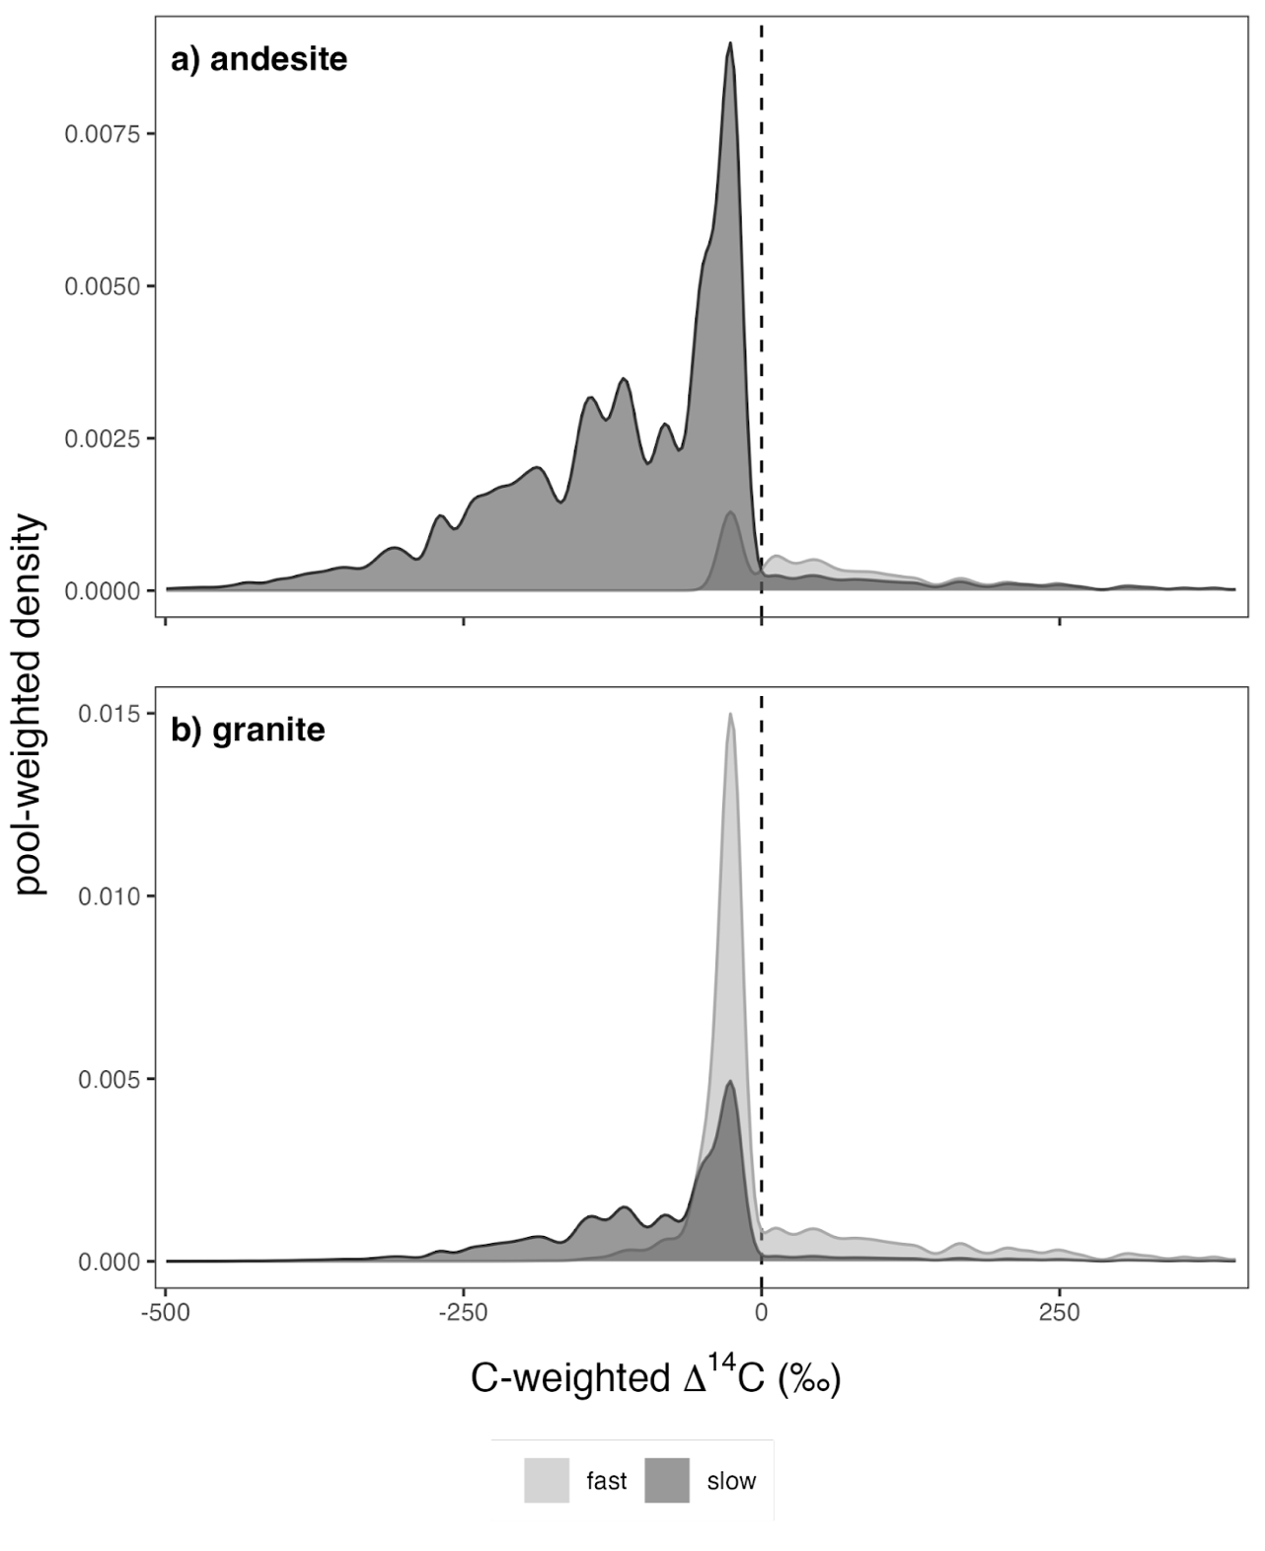
C/∆¹⁴C DISTRIBUTIONS: POOLS
density
overlap of slow and fast pools
Cool climate soils, 0.2-0.3 m, 2019
Notes:
Here you can see the long tail in the slow pool, but also the small proportion of modern carbon in the slow pool
And for the fast pool, you can see that the peak of the distribution is pre-modern, but the majority of the carbon is bomb-C

Slide 78
C/∆¹⁴C DISTRIBUTIONS: POOLS
density
Cool climate soils, 0.2-0.3 m, 2019
Notes:
And we can see the same resolution for the granitic soils
The peaks of the distributions for the fast and slow pools match what we observe in the fractions, but the fractions fail to capture the full spread of the data

Slide 79
OUTLOOK
&
CONCLUSIONS

Slide 80
OUTLOOK
500
250
Change in soil C stocks by 2100
(Pg C)
0
-250
-500
Ensemble of global soil C models
Model mean after adjusting temperature sensitivity (Q10)
Multi-model mean
± sd
(figure adapted from Todd-Brown et al., 2018)
Notes:
Taking it full circle…

Slide 81
OUTLOOK
inputs
+
500
250
Change in soil C stocks by 2100
(Pg C)
0
-250
-500
Ensemble of global soil C models
Model mean after adjusting temperature sensitivity (Q10)
Multi-model mean
± sd
(figure adapted from Todd-Brown et al., 2018)
Notes:
Let’s consider the effect of changes in inputs, and the persistence of those inputs, first

Slide 82
OUTLOOK
Relationship between soil mineralogy and transit time informs soil C response to shifts in inputs
Notes:
As I showed in the results section, soil mineralogy---specifically parent material---affected the estimated transit times
And this relationship can inform our expectations for changes in soil carbon stocks in response to changes in inputs

Slide 83
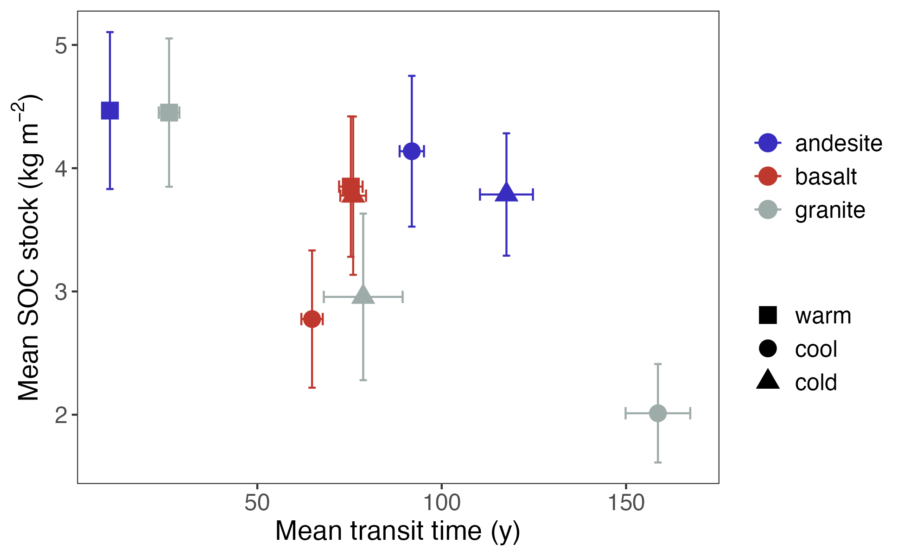
OUTLOOK
Relationship between soil mineralogy and transit time informs soil C response to shifts in inputs
Notes:
To illustrate this, we can see from this figure that in general, more carbon storage in soils is associated with faster cycling soil C, or faster transit times
However, we can see that this relationship is different among the different parent materials

Slide 84
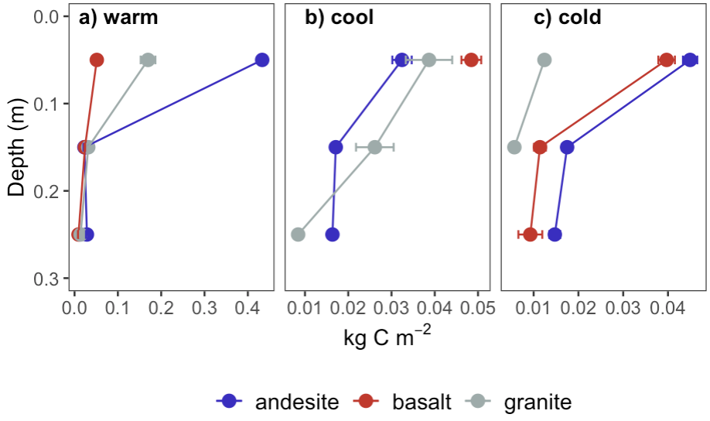
OUTLOOK
Soil C inputs
Notes:
I haven’t shown these data yet, but you may recall that I was able to estimate soil carbon inputs using the measured stocks and the fitted models
You can see that inputs decline consistently with increasing soil depth
But we can also see that climate has a strong influence on inputs

Slide 85
OUTLOOK
Soil C inputs
Notes:
Looking at the x-axis, you can see that the inputs for the surface layer of the warm climate sites are around an order of magnitude higher than for the surface layers in the cool and cold climate sites

Slide 86
OUTLOOK
cold
cool
warm
Notes:
What will happen as our climate envelopes shift upward in elevation?

Slide 87
OUTLOOK
Can we predict soil C gains or losses in response predicted changes in the climate envelope?
cool
warm
Notes:
Can we predict soil C gains or losses in response to changes in soil C inputs?
To test this, I ran a simulation in which I increased inputs to the cool climate soils for both the granitic and andesitic sits to match those currently seen for the warm climate andesitic soil

Slide 88


OUTLOOK
cool -> warm
cool
warm
435 gC m⁻²
Notes:
In this figure the dashed line shows expected C sequestration at the current cool climate sites, while the solid line shows the expected gains with increased inputs

Slide 89
OUTLOOK
cool -> warm
+29
+19
cool
warm
435 gC m⁻²
Notes:
You can see that given the same inputs [435 grams of carbon per meter squared] we see larger gains in the andesitic soils which have longer transit times

Slide 90
OUTLOOK
cool -> warm
+29
+19
cold -> cool
cool
warm
435 gC m⁻²
Notes:
You can see that given the same inputs [435 grams of carbon per meter squared] we see larger gains in the andesitic soils which have longer transit times

Slide 91
OUTLOOK
500
250
Change in soil C stocks by 2100
(Pg C)
0
-250
+
decomposition
-500
Ensemble of global soil C models
Model mean after adjusting temperature sensitivity (Q10)
Multi-model mean
± sd
(figure adapted from Todd-Brown et al., 2018)
Notes:
OK, now let’s consider how what we’ve learned about the effect of soil mineralogy on the temperature sensitivity of decomposition may impact future soil carbon stock changes

Slide 92
OUTLOOK
cold
cool
warm
Notes:
Let’s return to this scenario in which our current climate envelopes are shifting upward

Slide 93
OUTLOOK
Can we predict soil C gains or losses in response to changes in decomposition rates?
cool
warm
Notes:
Now the question I want to ask is, “Can we predict soil C gains or losses in response to changes in decomposition rates?”
The idea here is that if rising temperatures have an impact on decomposition rates, one expectation is that future soil C dynamics at the current cold climate sites will shift to match what we see today at the cool climate sites
In order to isolate the effect of a potential shift in decomposition rates, I set the inputs for all sites to the level observed for the current cool climate andesite soil

Slide 94


OUTLOOK
a) andesite
+0.2
cool
warm
inputs = 31 gC m⁻²
Notes:
So for the andesitic soils, for which we did not observe any relationship between transit time and temperature, we do not see much of a change in soil carbon sequestration
[note that, counter-intuitively, cool climate soils had slightly longer transit time than cold climate soils]

Slide 95
OUTLOOK
a) andesite
+0.2
b) granite
-0.9
cool
warm
inputs = 31 gC m⁻²
Notes:
Turning to the granitic soils, we see a larger impact
Here we see that the cold to cool climate shift results in soil C losses
And this makes sense given the strong relationship I observed between transit time and mean annual temperature in these soils

Slide 96
OUTLOOK – FUTURE QUESTIONS
Notes:
So looking to the future, I identified a few questions that build on the findings from my PhD work

Slide 97
OUTLOOK – FUTURE QUESTIONS
How will pool-specific decomposition rates change? (For example, increases in turnover of the fast pool, but not the slow pool)
Further fractionation of density fractions could help answer this question
Notes:
thermal fractionation

Slide 98
OUTLOOK – FUTURE QUESTIONS
How will pool-specific decomposition rates change? (For example, increases in turnover of the fast pool, but not the slow pool)
Further fractionation of density fractions could help answer this question
What will happen to current “warm” climate sites?
Expand the range of sites considered to included warmer climate site
Notes:
Will we see a tipping point in soil moisture that leads to decreases in soil carbon inputs?

Slide 99
OUTLOOK – FUTURE QUESTIONS
How will pool-specific decomposition rates change? (For example, increases in turnover of the fast pool, but not the slow pool)
Further fractionation of density fractions could help answer this question
What will happen to current “warm” climate sites?
Expand the range of sites considered to included warmer climate site
What about soil C in deeper layers?
Find archives with deeper samples
New soil warming experiments

Slide 100
CONCLUSIONS
Soil mineralogy is critical for explaining ages & transit times – temperature alone is inadequate

Slide 101
CONCLUSIONS
Soil mineralogy is critical for explaining ages & transit times – temperature alone is inadequate
Transit time temperature sensitivity is moderated by mineralogical factors, i.e., mineral control matters for fast cycling soil C, too

Slide 102
CONCLUSIONS
Soil mineralogy is critical for explaining ages & transit times – temperature alone is inadequate
Transit time temperature sensitivity is moderated by mineralogical factors, i.e., mineral control matters for fast cycling soil C, too
Distributions of ages and transit times are more informative than means
Notes:
When it comes to empirical measurements, we need to ask ourselves whether or not the measurements represent homogenous pools or mixtures

Slide 103
CONCLUSIONS
Soil mineralogy is critical for explaining ages & transit times – temperature alone is inadequate
Transit time temperature sensitivity is moderated by mineralogical factors, i.e., mineral control matters for fast cycling soil C, too
Distributions of ages and transit times are more informative than means
Partitioning fast and slowly cycling mineral-associated soil C pools could improve predictions of future changes in soil C stocks

Slide 104
DeepSoil 2100 & SWEDDIE

Slide 105
WHAT IS DeepSoil 2100?
DeepSoil 2100: Global network of whole soil warming experiments
J. Beem-Miller
Notes:
All of the sites in the network were set up independently, and designed to answer specific questions
Largely united in the emphasis on constructing a carbon budget, but with different instrumentation, methodologies, and specific science questions
Can we gain a more nuanced, comprehensive understanding of which processes are affected in which settings? The first step is to create a synthesized database…

Slide 106
WHAT IS SWEDDIE?
DeepSoil 2100: Global network of whole soil warming experiments
SWEDDIE: Soil Warming Experiment to Depth Data Integration Effort (a database)
`
`
`
`
`
`
J. Beem-Miller
Notes:
All of the sites in the network were set up independently, and designed to answer specific questions
Largely united in the emphasis on constructing a carbon budget, but with different instrumentation, methodologies, and specific science questions
Can we gain a more nuanced, comprehensive understanding of which processes are affected in which settings? The first step is to create a synthesized database…

Slide 107
WHAT IS SWEDDIE?
DeepSoil 2100: Global network of whole soil warming experiments
SWEDDIE: Soil Warming Experiment to Depth Data Integration Effort (a database)
Comparative approach:
Model-data integration, coordinated sampling, benchmarking
J. Beem-Miller
Notes:
All of the sites in the network were set up independently, and designed to answer specific questions
Largely united in the emphasis on constructing a carbon budget, but with different instrumentation, methodologies, and specific science questions
Can we gain a more nuanced, comprehensive understanding of which processes are affected in which settings? The first step is to create a synthesized database…

Slide 108

WARMING EXPERIMENTS
Alpine forest
figure from M. Schmidt
J. Beem-Miller
Notes:
Of these sites, 7 have nearly identical design with resistance heating rods extending greater than 1 m into the soil:
Pt. Reyes, Blodgett, SPRUCE, SMARTX, SWELTR, ACBB, TEAM
A further 6 have some combination of resistance heating rods and infrared surficial heating
B4WARMED, BioCon, Harvard Forest, TRACE, Achenkirch, Sanming
Two sites have other mechanisms of heating, e.g., CIPEHR (snow removal) and FORHOT (geothermal)

Slide 109






WARMING EXPERIMENTS
J. Beem-Miller
Notes:
30% increase in CO2 production over the whole soil profile
Difference in top soil and subsoil processes

Slide 110

BLODGETT FOREST EXAMPLE
Blodgett Forest
+ 4 °C
(figure from Soong et al., 2021)
J. Beem-Miller
Soong et al., 2021. Five years of whole-soil warming led to loss of subsoil carbon stocks and increased CO2 efflux. Sci. Adv.
Notes:
Losses observed in subsoil
non-sig gains in top 20 cm
1/3 of SOC stocks after just 4 and half years of warming (3.21±1.0 kg C m−2)
Primarily particulate organic matter

Slide 111
BLODGETT FOREST EXAMPLE
Blodgett Forest
+ 4 °C
(figure from Soong et al., 2021)
J. Beem-Miller
Soong et al., 2021. Five years of whole-soil warming led to loss of subsoil carbon stocks and increased CO2 efflux. Sci. Adv.
Notes:
30% increase in CO2 production over the whole soil profile
Difference in top soil and subsoil processes

Slide 112

THE ROLE OF DEPTH?
(Fig. from Hicks Pries et al., 2023, DOI:10.1146/annurev-ecolsys-102320-085332)
J. Beem-Miller
Notes:
30% increase in CO2 production over the whole soil profile
Difference in top soil and subsoil processes

Slide 113

NEXT STEPS
Methods
∆¹⁴C
ecosystem respiration
lab incubations
modeling (ecosys, SoilR)
Sites
Blodgett (temp. forest)
B4WarmED (boreal/temp. forest)
ACBB (grassland/cropland)
SWELTR (tropical forest)
TEAM (permafrost)
J. Beem-Miller
Notes:
30% increase in CO2 production over the whole soil profile
Difference in top soil and subsoil processes

Slide 114

Thanks!
https://iscn.fluxdata.org/network/partner-networks/deepsoil2100/
Grassland Warming Experiment Site
Point Reyes, USA

Slide 115


DENSITY FRACTIONATION
“free light”
“occluded light”
mix soil (< 2mm) with heavy liquid
e.g., SPT @ 1.8 g cm⁻³
sedimentation
dispersion
e.g. sonication
“heavy”
(aka mineral-associated)
Figure adapted from Wagai et al. 2009
Notes:
So how do we quantify the amount of organic matter that persists due to interactions with soil minerals?
Density fractionation is one of the most common methods of doing this and relies on the difference in density between soil minerals and organic material
Organic matter bound to dense minerals will sink in a heavy solution, and can be separated from free floating organic matter, which we call the “free light fraction”
We can also separate organic matter found in soil aggregates, which are thought to promote soil carbon persistence, by dispersing these particles with high energy sound waves or glass beads. This is the occluded light fraction
[confirmed that I used 1.8 g cm-3, matching what was reported by Rasmussen et al., 2018]

Slide 116
HEAVY FRC ∆¹⁴C DISTRIBUTION
metal oxides
lipids/sugars
COOL
0.2-0.3 m
Clays
positive ∆¹⁴C = modern
Notes:
This figure shows the distribution of 14C within the mineral associated C pool for the three parent materials
Here we see clearly that the andesitic soils have two peaks, while the basaltic and granitic soils are unimodal, and the granite soil is mostly modern
decadal, centennial, millennial, respectively

Slide 117

PARALLEL vs SERIES
2-pool parallel
2-pool series
Age:
TT:
lag:
149 (96)
149 (102)
92 (35)
95 (32)
1
11
Notes:
put this as reserve

Slide 118
PARALLEL vs SERIES
2-pool parallel
2-pool series
Age:
TT:
lag:
149 (96)
149 (102)
92 (35)
95 (32)
1
11
Mean system age & transit time insensitive to model structure with only bulk and respired ∆¹⁴C constraints
Notes:
put this as reserve

Slide 119
OUTLOOK
a) cool -> warm
+29
+19
b) cold -> cool
cool
warm
14 gC m⁻² y⁻¹
32 gC m⁻² y⁻¹
Notes:
For the second scenario I shifted the inputs for the cold climate sites to match those currently estimated for the cool climate sites
In this scenario I didn’t use the same inputs for the granite and andesitic soils, but used the granitic soil estimates for the granitic soils and the andesitic soils estimates for the andesitic soils

Slide 120
OUTLOOK
a) cool -> warm
+29
+19
b) cold -> cool
+2.4
cool
warm
-0.6
14 gC m⁻² y⁻¹
32 gC m⁻² y⁻¹
Notes:
This results in a small decrease in inputs for the andesitic soils, and moderate increase for the granitic soils

Slide 121
FRACTION vs. RESPIRED ∆¹⁴C
free light
heavy
Notes:
put this as reserve

Slide 122

FRACTION vs. RESPIRED ∆¹⁴C
free light
heavy
Notes:
put this as reserve

Slide 123

LAG TIMES

Slide 124

SOIL MOISTURE
Notes:
granite transect

Slide 125
STUDY SITES
Basalt
Soil organic C stocks (0-0.3 m)
kg m⁻²
Warm
Cool
Cold
Andesite
Basalt | 8.8 (3.0) | 6.7 (0.6) | 6.4 (0.7)
Andesite | 13.0 (1.1) | 10.4 (2.9) | 10.1 (4.0)
Granite | 8.5 (1.3) | 6.0 (0.5) | 4.8 (0.1)
Granite
100 km
Data from Rasmussen et al., 2006 & 2018
Notes:
Differences in carbon storage
No big changes 2001-2019, i.e., steady-state

Slide 126

WETNESS INDEX & AGE
Notes:
Parent material highly correlated with system age, as is soil wetness (MAP - ET)
But can't separate wetness effect from PM

Slide 127
IMPORTANCE OF MINERALS
Predominant mechanisms of mineral-organic association varies by mineral
goethite
vermiculite
Data from Mikutta et al., 2007
Notes:
Well a simple explanation is that mineral-associated soil carbon is not a homogeneous pool
Soils contain a diverse array of mineral species, and these different minerals bind to soil organic matter via different mechanisms
These images show three examples of very physically different soil mineral species, although mineral-organic interactions are also strongly affected by the charge of the mineral particles and the presence of difference functional groups on the mineral surfaces
[arrow shows organic matter accumulation
missing for other minerals because of masking by gold particles during sample preparation prior to imaging]

Slide 128
IMPORTANCE OF MINERALS
Predominant mechanisms of mineral-organic association varies by mineral
goethite
vermiculite
Short-range order
2:1 clay
Data from Mikutta et al., 2007
Notes:
Well a simple explanation is that mineral-associated soil carbon is not a homogeneous pool
Soils contain a diverse array of mineral species, and these different minerals bind to soil organic matter via different mechanisms
These images show three examples of very physically different soil mineral species, although mineral-organic interactions are also strongly affected by the charge of the mineral particles and the presence of difference functional groups on the mineral surfaces
[arrow shows organic matter accumulation
missing for other minerals because of masking by gold particles during sample preparation prior to imaging]

Slide 129
IMPORTANCE OF MINERALS
Predominant mechanisms of mineral-organic association varies by mineral
Mineral type matters for soil C persistence
goethite
vermiculite
Short-range order
2:1 clay
 | Min-OM sorption type
 | Ligand exch. | Ca⁺⁺ & precip. | Van der Waals
goethite | 92% | n.d. | 8%
vermiculite | 7% | 78% | 14%
Data from Mikutta et al., 2007
Notes:
You can see this in this table here, which gives the relative importance of these three different sorption mechanisms for these three minerals
Well a simple explanation is that mineral-associated soil carbon is not a homogeneous pool
Soils contain a diverse array of mineral species, and these different minerals bind to soil organic matter via different mechanisms
These images show three examples of very physically different soil mineral species, although mineral-organic interactions are also strongly affected by the charge of the mineral particles and the presence of difference functional groups on the mineral surfaces
[arrow shows organic matter accumulation
missing for other minerals because of masking by gold particles during sample preparation prior to imaging]

Slide 130
2-PP vs 2-PS MODELS
Out
a) Parallel
𝜏_{fast}: 17 (12) y
𝜏_{slow}: 161 (111) y
Age: 149 (96) y
TT: 92 (31) y
Lag: 1 y
(49)
48%
(388)
23.5
In
fast: 48%
slow: 52%
52%
25.5
(4119)
Out
b) Series
𝜏_{fast}: 10 (2) y
𝜏_{slow}: 176 (107) y
Age: 149 (102) y
TT: 95 (33) y
Lag: 11 y
(39)
100%
(401)
15.2
In
fast: 39%
slow: 61%
61%
23.8
(4160)

Slide 131

STUDY SITES
Notes:
North to south parent material gradient, climate gradient east to west
All conifer dominated
timeseries of ∆14C
respired = laboratory incubations

Slide 132
BAYESIAN LINEAR MODELS
Mineral model:
$$\ln\left(μ_{i}\right)= β_{0}+ β_{ox} ∙ {OX}_{i}+ β_{d} ∙ d_{i}+ β_{ox}β_{d} ∙ {OX}_{i} ∙ d_{i}$$
Temperature model:
$$μ_{ij}= β_{0_{j}}+ β_{T_{j}} ∙ T_{i}+ β_{d} ∙ d_{i}+ β_{d}β_{T} ∙ T_{i} ∙ d_{i}$$
Notes:
North to south parent material gradient, climate gradient east to west
All conifer dominated
timeseries of ∆14C
respired = laboratory incubations

Slide 133
BAYESIAN LINEAR MODELS
Mineral model:
$$\ln\left(μ_{i}\right)= β_{0}+ β_{ox} ∙ {OX}_{i}+ β_{d} ∙ d_{i}+ β_{ox}β_{d} ∙ {OX}_{i} ∙ d_{i}$$
Al_{ox} + ½ Fe_{ox}
depth
interaction
Notes:
North to south parent material gradient, climate gradient east to west
All conifer dominated
timeseries of ∆14C
respired = laboratory incubations

Slide 134
BAYESIAN LINEAR MODELS
Temperature model (hierarchical):
$$μ_{ij}= β_{0_{j}}+ β_{T_{j}} ∙ T_{i}+ β_{d} ∙ d_{i}+ β_{d}β_{T} ∙ T_{i} ∙ d_{i}$$
j₁ = parent material₁
temperature
depth
interaction
Notes:
North to south parent material gradient, climate gradient east to west
All conifer dominated
timeseries of ∆14C
respired = laboratory incubations

Slide 135

SIERRA SITES MINERALOGY
Data from Rasmussen et al., 2018
Notes:
North to south parent material gradient, climate gradient east to west
All conifer dominated
timeseries of ∆14C
respired = laboratory incubations

Slide 136

IMPORTANCE OF MINERALS
Global distribution of C in fractions (<0.3 m)
Fraction
free light
heavy
% of bulk C
Figure adapted from Heckman & Hicks-Pries et al. 2021
Notes:
So the figures on the right are from a global study I was involved with where we looked at the distribution and radiocarbon content of density fractionations, with the goal of quantifying the importance of mineral-associations for soil carbon persistence and accumulation

Slide 137
IMPORTANCE OF MINERALS
Majority of soil C is mineral-associated (“heavy”)
Global distribution of C in fractions (<0.3 m)
Fraction
free light
heavy
% of bulk C
Figure adapted from Heckman & Hicks-Pries et al. 2021
Notes:
So we see from the figure that the majority of soil organic matter is found in association with minerals
Carbon concentrations are usually lower in heavy fractions, but there is more carbon there overall

Slide 138
IMPORTANCE OF MINERALS
Majority of soil C is mineral-associated (“heavy”)
Some mineral-associated C very old…
Global distribution of ∆¹⁴C in fractions (<0.3 m)
Fraction
free light
heavy
∆¹⁴C
Figure adapted from Heckman & Hicks-Pries et al. 2021
Notes:
Turning to radiocarbon, we also see differences between the fractions
What we can see in this figure is that very old (very negative ∆14C values) mineral-associated C occurs in some soil, but globally, the heavy fraction C is surprisingly young
You can see this from the median – dotted line – which is just below zero

Slide 139
IMPORTANCE OF MINERALS
Majority of soil C is mineral-associated (“heavy”)
Some mineral-associated C very old…
…but ca. 50% of mineral-associated C is “modern” (i.e., contains bomb C)
Global distribution of ∆¹⁴C in fractions (<0.3 m)
Fraction
free light
heavy
∆¹⁴C
>10² y
”modern”
Figure adapted from Heckman & Hicks-Pries et al. 2021
Notes:
This tells us that mineral mineral associated soil organic matter contains quite a bit of bomb-C, and therefore must be turning over on decadal timescales
[n ~1200-1400]

Slide 140
STUDY 1: OVERALL RESULTS

Slide 141
STUDY 1: STORAGE EFFECTS

Slide 142
STUDY 1: HAINICH

Slide 143
STUDY 1: PRE-INC EFFECT

Slide 144
∆¹⁴C RESPIRED vs BULK

Slide 145
∆¹⁴C vs REACTIVE MINERALS

Slide 146
SOIL ORGANIC C STOCKS

Slide 147

STUDY 3: MODEL FITS (0-0.1 m)

Slide 148

STUDY 3: MODEL FITS (0.1-0.2 m)

Slide 149

STUDY 3: MODEL FITS (0.1-0.2 m)

Slide 150
STUDY 3: MAT & SYSTEM AGE

Slide 151
STUDY 3: MAT & TRANSIT TIME

Slide 152

STUDY 3: DEPTH DEPENDENCE

Slide 153

STUDY 3: MODEL SOIL C STOCKS
2-pool parallel model

Slide 154

SYNTHESIS: FRACTION ∆¹⁴C

Slide 155

WELL-MIXED? OR LONG TAIL?
0-0.1 m
a) andesite
b) granite
log (TT)
log (age)
Notes:
quartiles of the age and transit time distributions, bottom left point is 25th quartile, upper right is 75th
granite is generally well mixed, and especially for the cold climate site, behaves like a one pool system
long tail evident in the hook of the 75th quartile
missing for the cold climate site, possibly because soils are not as well developed (lower concentrations of poorly crystalline minerals)

Slide 156
BULK SOIL ∆¹⁴C
0-0.1 m
257
102
54
∆¹⁴C
older
younger
Notes:
MAT relationship: strongest for GR, weak for BS, bizarre for AN
[gradient with climate colors]

Slide 157
BULK SOIL ∆¹⁴C
0-0.1 m
1049
183
134
∆¹⁴C
much older
–––– younger ––––
Notes:
MAT relationship: strongest for GR, weak for BS, bizarre for AN

Slide 158
BULK SOIL ∆¹⁴C
0-0.1 m
149
187
163
∆¹⁴C
no gradient
Notes:
MAT relationship: strongest for GR, weak for BS, bizarre for AN

Slide 159
RESPIRED ∆¹⁴C-CO₂
0-0.1 m
younger
older
younger
∆¹⁴C
10
75
26
Notes:
AN has shortest TT!

Slide 160
RESPIRED ∆¹⁴C-CO₂
0-0.1 m
older
–––– younger ––––
∆¹⁴C
118
76
79
Notes:
AN oldest TT, but not by much

Slide 161
RESPIRED ∆¹⁴C-CO₂
0-0.1 m
older
younger
oldest
∆¹⁴C
92
65
159
Notes:
GR oldest despite lack of gradient in ages

Slide 162
INCUBATIONS

Slide 163

INCUBATIONS

Slide 164
INCUBATIONS

Slide 165

INCUBATIONS

Slide 166
INCUBATIONS

Slide 167

INCUBATIONS

Slide 168

STUDY SITES
Poorly crystalline mineral abundance (Al_{ox} + ½ Fe_{ox}) in the continental United States
Data from Slesserav et al., 2022
Notes:
red = primary mineral derived
blue = secondary mineral derived

Slide 169


WEATHERING & PCMs
Data from Slesserav et al., 2022
Notes:
relationship between PCM abundance and SOC stocks strongest in humid climates with strong weathering potential, but only if adequate primary mineral stocks remain to fuel transformation of primary minerals into reactive secondary mineral products
influence of PCMs on SOC abundance (and C cycling rates) strongest at local or regional scales

Slide 170

WEATHERING & PCMs
Data from Kramer and Chadwick, 2018
Notes:
relationship between PCM abundance and SOC stocks strongest in humid climates with strong weathering potential, but only if adequate primary mineral stocks remain to fuel transformation of primary minerals into reactive secondary mineral products
influence of PCMs on SOC abundance (and C cycling rates) strongest at local or regional scales

Slide 171
WEATHERING & PCMs
Range of MAP-PET in this study
Data from Kramer and Chadwick, 2018
Notes:
DOC extracted with pyrophosphate-dithionite (crystalline + non/poorly crystalline forms)
St

Slide 172

GLOBAL C BUDGET
(figure from Friedlingsten et al., 2022)
Notes:
point out decrease in land use change emissions

Slide 173

LAND C FLUX PREDICTIONS
emissions pathways
(figure from IPCC AR6, 2023)

Slide 174
SOIL C CHANGES
500
250
0
-250
-500
(figure adapted from Todd-Brown et al., 2018)

Slide 175
SOIL C INPUTS VS LOSSES
inputs
+
500
250
Change in soil C stocks by 2100
(Pg C)
0
-250
-500
+ decomposition
Ensemble of global soil C models
Model mean after adjusting temperature sensitivity (Q10)
Multi-model mean
± sd
(figure adapted from Todd-Brown et al., 2018)
J. Beem-Miller
Notes:
30% increase in CO2 production over the whole soil profile
Difference in top soil and subsoil processes

